Slide 1

Unit-3 Sensors, Microcontrollers and Interfacing
Internet of Things (IoT)
DU #2101CS631
Prof. Bhushan D. Joshi
Computer Engineering Department
bhushan.joshi@darshan.ac.in
+91 8485979997

Slide 2
Sensors, Microcontrollers and interfacing
Serial Communication - UART
I2C Protocol
MQTT Protocol
Sensors and Sensor Modules interfacing
IoT Data communication and Interfacing
SPI Protocol

Slide 3
IoT Data communication and Interfacing : Protocols
IoT Data Communication Interfaces:
IoT Messaging Protocols:
IoT Network Protocols:
MQTT
Bluetooth Low Energy
UART Serial communication
SPI
I2C
CoAP
AMQP
Zigbee with Xbee Module.

Slide 4
IoT Communication
The prime focus of the internet of things is to offer communication between various objects that are not traditional computers.
The connection of devices over the internet.
These smart devices communicate with each other , exchange data , perform some tasks without any human involvement.
These devices are embedded with electronics, software, network and sensors which help in communication.
There are various protocols in IoT established to offer communication among them.
Communication enables these devices to gather, exchange data which contribute in success of that IoT product/project.
An "IoT protocol" is a set of rules and standards that govern how devices within an Internet of Things (IoT) network communicate and exchange data with each other.

Slide 5
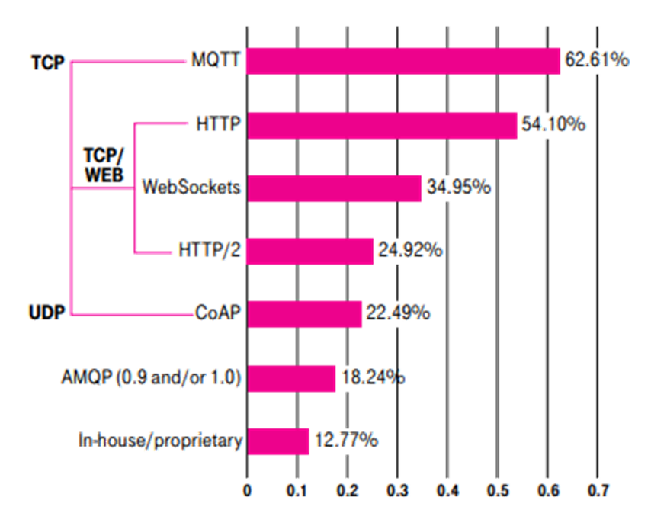
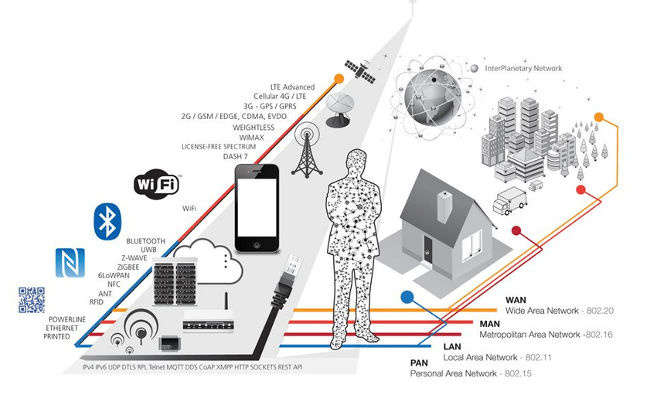
IoT Communication

Slide 6
Serial Communication Protocols
I2C- Protocol
Asynchronous Serial Communication : UART
SPI (Serial Peripheral Interface) Protocol

Slide 7
Serial Communication
In Embedded Systems, Telecommunication, and Data Transmission applications, Serial Communication is known to be the process of sending data one bit at a time (bit-by-bit) sequentially, over the serial bus.
It takes a complete clock cycle in order to transfer each bit from a one end to the other.
Types:
Synchronous: Data is transmitted with a clock signal (e.g., SPI, I²C).
Asynchronous: No clock signal is required; devices agree on data rate (e.g., UART).

Slide 8
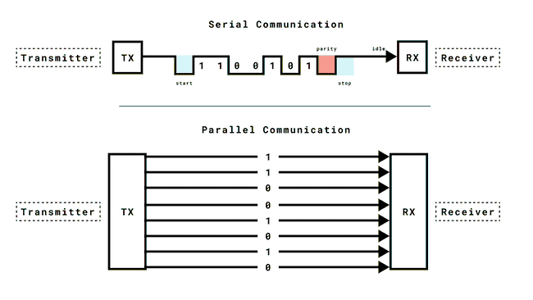
Serial Communication vs Parallel Communication
Conversely, Parallel Communication is known to be the process of sending several bits, even bytes, as a whole only in a single clock cycle.
Advantages of Serial Communication
Simpler wiring and reduced cost.
Suitable for long-distance communication (e.g., USB, RS-485).
Less chance of signal interference.
Advantages of Parallel Communication
Faster data transfer rates (used in high-speed buses like PCIe).
Suitable for applications requiring large amounts of data to be transferred quickly over short distances (e.g., inside computers).
Serial Communication: Arduino to sensors or PCs via UART, SPI, I²C.
Long-distance communication (e.g., RS-232, Ethernet, USB).
Parallel Communication: Internal hardware communication in computers (e.g., CPU to RAM via memory buses).
Printers (parallel ports like Centronics in older models).

Slide 9


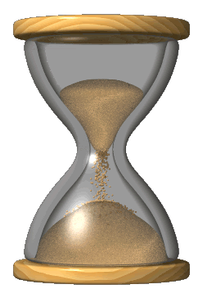
Serial Communication : UART
Universal Asynchronous Receiver-Transmitter (UART)
Universal Asynchronous Receiver-Transmitter (UART), a serial communication protocol that can be used to send data between an Arduino board and other devices.
It allows an asynchronous serial communication in which the data format and transmission speed are configurable.
UART is one of the most used device-to-device (serial) communication protocols.
It is very simple, low-cost and easy to implement.
Asynchronous
Synchronous

Slide 10
Arduino : Serial Class
Communication via UART is enabled by the Serial class, which has a number of methods available, including reading & writing data.
The Serial class have several methods with some of the essentials being:
begin() - begins serial communication, with a specified baud rate
(many examples use either 9600 or 115200).
print() - prints the content to the Serial Monitor.
println() - prints the content to the Serial Monitor, and adds a new line.
available() - checks if serial data is available or not. (if you send a command from the Serial Monitor).
read() - reads data from the serial port.
write() - writes data to the serial port.

Slide 11
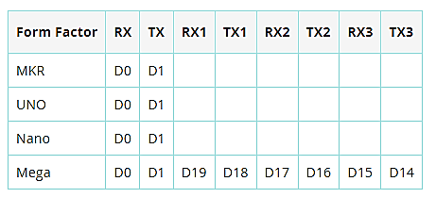
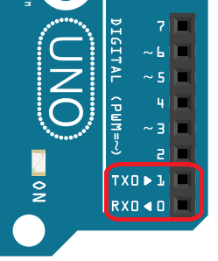
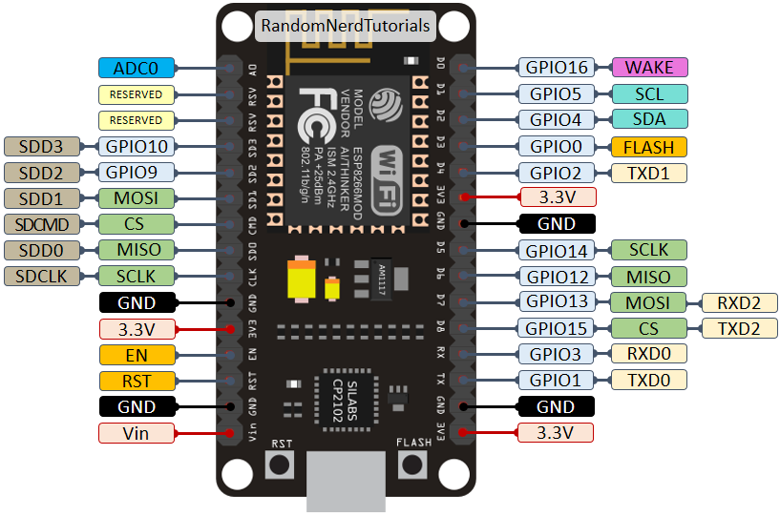
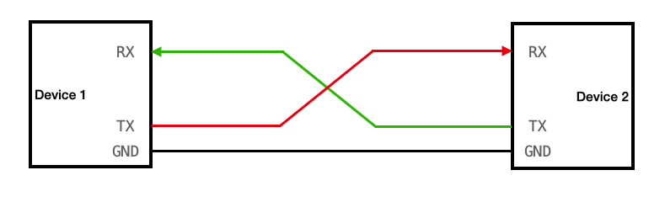
Arduino UART Pins
The default TX/RX pins on an Arduino board are the D0(RX) and D1(TX) pins.
Some boards have additional serial ports, see table below:

Slide 12
How UART Works ?
UART operates by transmitting data as a series of bits, including
Start bit
data bits
an optional parity bit,
stop bit(s).
Unlike parallel communication, where multiple bits are transmitted simultaneously, UART sends data serially, one bit at a time.
As the name reveals the protocol operates asynchronous which means that it doesn't rely on a shared clock signal.
Instead, it uses predefined baud rates to determine the timing of data bits.

Slide 13
UART Communication
Key Components:
1)The Transmitter 2)The Receiver 3)The Baud Rate
The transmitter collects data from a source, formats it into serial bits, and sends it via a TX (Transmit) pin.
The receiver receives it via a RX (Receive) pin, processes incoming serial data and converts it into parallel data for the host system.
Baud Rate :The baud rate is specified in bits per second (bps) and represents the number of bits transmitted in one second.
The baud rate determines the speed of data transmission.
In UART, both the transmitting and receiving devices must agree on the same baud rate to ensure successful communication.

Slide 14

UART : Flow Control
UART Flow Control is a method for slow and fast devices to communicate with each other over UART without the risk of losing data.
Flow control provides extra signalling to inform the transmitter that it should stop (pause) or start (resume) the transmission.
Consider the case where two units are communicating over UART.
a transmitter T is sending a long stream of bytes to a receiver R.
R is a slower device than T, and R cannot keep up.
R needs to either do some processing on the data or empty some buffers before it can keep receiving data.
R needs to tell T to stop transmitting for a while.

Slide 15
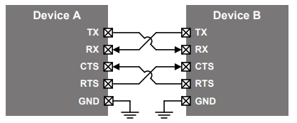
UART : Flow Control
Several forms of flow control exist.
Hardware flow control :
It uses extra wires, where the logic level on these wires define whether the transmitter should keep sending data or stop.
Software flow control :
Special characters are sent over the normal data lines to start or stop the transmission.
UART hardware flow control is fully supported by UART driver, and UART software flow control is partially supported by the driver.

Slide 16

UART : Hardware flow control (also called RTS/CTS flow control)
Two extra wires are needed in addition to the data lines.
They are called RTS (Request to Send) and CTS (Clear to Send).
These wires are cross-coupled between the two devices, so RTS on one device is connected to CTS on the remote device and vice versa.
Traffic hai..abhi rukna padega
Time lagela..RTS se pahele…ladoo kha leta hu
Why do they stop us?

Slide 17
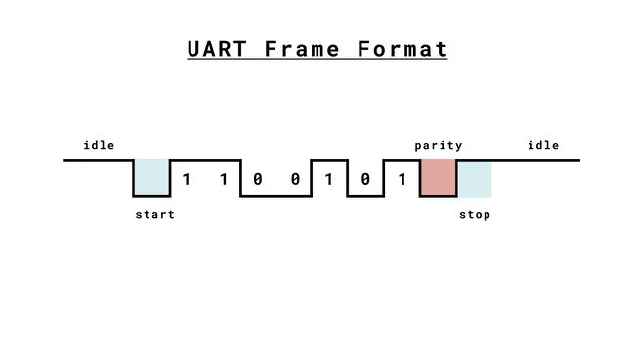
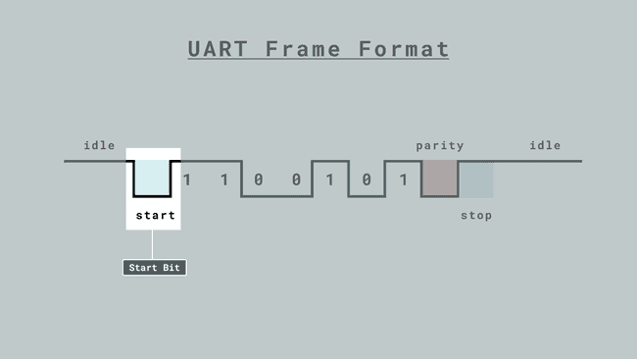
UART Messages
Each data frame is encapsulated by start and stop bits.
These bits serve a vital role in establishing the boundaries of data transmission and ensuring synchronization between the sender and receiver.
Start Bit :
A single start bit is transmitted at the beginning of each UART frame.
The start bit is always logic low (0) for UART communication.
When the receiver detects a start bit, it knows that a new data frame is beginning, and it prepares to receive the incoming bits.

Slide 18
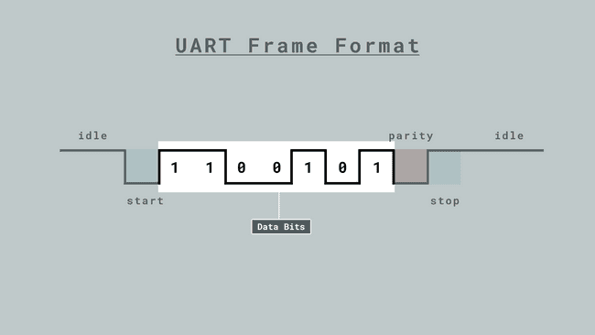
UART Messages
Data Bits :
Data bits are a fundamental component of UART communication as they carry the actual information to be transmitted.
The number of data bits in a UART frame can vary, but a common and widely used configuration is 8 bits or 7-bit or 6-bit.
Character Size :
The character size in UART communication is defined by the number of data bits within a frame.
8-Bit: This is the most prevalent character size in UART communication.
7-Bit: In cases where data size needs to be smaller, 7-bit character size is utilized.
6-Bit: For even more compact data representation.

Slide 19
UART Communication : Data Encoding And Parity
Data Encoding :
Data bits represent the characters or data using binary encoding, where each bit corresponds to a power of 2.
This encoding allows for the transmission of a wide range of information, making UART versatile for various data types, from simple text characters to complex binary data.
Parity Bit :
The parity bit is a bit added to the transmitted data and tells the receiver if the number of 1’s in the data transmitted is odd or even.
The possible setting for Parity Bit is Odd or Even.
ODD – the parity bit is ‘1’ if there is an odd number of 1’s in the data frame
EVEN – the parity bit is ‘0’ if there is an even number of 1’s in the data frame

Slide 20
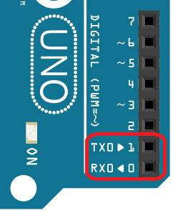
Arduino UNO : Serial Communication
Arduino has one or more UART pins depending on the board.
Arduino Uno has only one UART interface found on pin 0 (RX0) and pin 1 (TX0).
Figure shows the location of the UART TX and RX pins.
The Arduino pins 0 and 1 are also used for communicating with the Arduino IDE via the USB.
So if you will upload sketches to your UNO, be sure to first disconnect any wires on pins 0 and 1
In Arduino serial communication, the default number of data bits is 8

Slide 21
Serial Functions
Check the Port
Read
Write Data
if(Serial)
available()
availableForWrite()
begin()
end()
print()
println()
read()
peek()
readBytes()
readBytesUntil()
readString()
readStringUntil()
flush()
write()
Start / Stop
Print on Serial Monitor

Slide 22
Communication Functions
Serial.begin() : Initializes serial communication
Serial.end() : Ends serial communication
Serial.available() : Gets the number of bytes available for reading
Serial.read() : Reads 1Byte serial data
Serial.peek() : Reads 1Byte serial data without removing it from the buffer
Serial.flush() : Waits for the transmission of the serial data to complete
Serial.write() : Data transmission
Serial.print() : Send string (no line feed)
Serial.println() : Send string (with line feed)

Slide 23
Serial Port availability Read Data
sketch_01.ino
1
2
3
4
5
6
7
8
9
10
11
12
13
14
15
int incomingByte = 0;
// for incoming serial data
void setup() {
Serial.begin(9600);
// sets data rate to 9600 bps
}
void loop() {
// reply only when you receive data: if (Serial.available() > 0) {
// read the incoming byte: incomingByte = Serial.read();
// say what you got:
Serial.print("I received: "); Serial.println(incomingByte, DEC); } }
sketch_01.ino
1
2
3
4
5
6
7
8
9
10
11
12
void setup() { //Initialize serial //and wait for port to //open: Serial.begin(9600); while (!Serial) { ;
// wait for serial //port to connect. //Needed for native //USB
}
}

Slide 24
To Write data on Serial port : Serial.write()
Serial.write()
For the Data transmission
Syntax:- Serial.write(data)
Parameter: data ⇒ The value to send
Serial.write(buf, len)
Parameter:
buf ⇒ The array to send
len ⇒ The number of bytes
Return: Bytes of data to be sent
Write.ino
1
2
3
4
5
6
7
8
9
10
11
12
void setup() {
Serial.begin(9600);
//To Start Serial Communication
}
void loop() {
Serial.write('A');
//Write one byte data
Serial.write(0x04);
delay(1000);
// Wait for one second
}

Slide 25
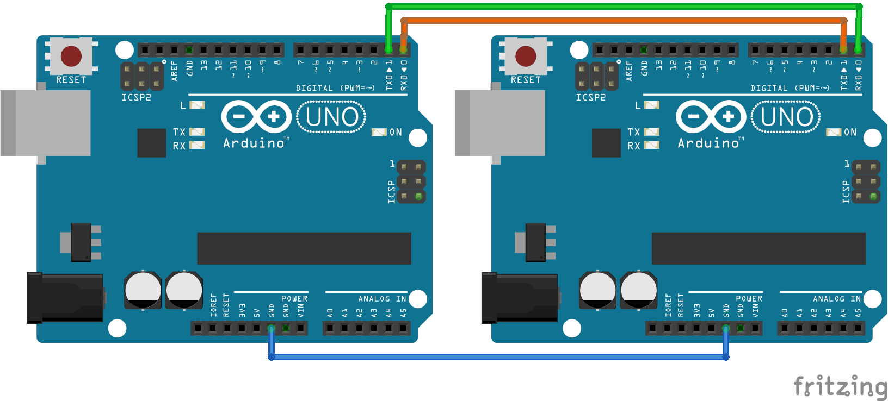
Serial Communication between Two Arduino Board

Slide 26
Code for Sender -Receiver Arduino
receiver.ino
Sender.ino
char mystr[10];
//Initialized variable to store received data
void setup() {
// Begin the Serial at 9600 Serial.begin(9600); }
void loop() {
Serial.readBytes(mystr,5);
//Read the serial data and //store in var
Serial.println(mystr);
//Print data on Serial //Monitor
delay(1000);
}
1
2
3
4
5
6
7
8
9
10
11
12
13
14
15
1
2
3
4
5
6
7
8
9
10
11
12
char mystr[5] ="Hello";
//String data
void setup() {
// Begin the Serial at //9600 Baud Serial.begin(9600); }
void loop() {
Serial.write(mystr,5);
//Write the serial data
delay(1000);
}

Slide 27
Software Serial Port
Arduino boards have built in support for serial communication on pins 0 and 1, but what if you need more serial ports?
The SoftwareSerial Library has been developed to allow serial communication to take place on the other digital pins of your boards, using software to replicate the functionality of the hardwired RX and TX lines
The SoftwareSerial library in Arduino allows you to create additional serial communication ports on digital pins, which is useful if the hardware UART (pins 0 and 1 on most Arduinos) is already in use.
This enables you to communicate with multiple devices (e.g., sensors, modules) that use serial communication.
#include <SoftwareSerial.h>

Slide 28
Software Serial
The SoftwareSerial library implements serial communication in software, using any pair of digital pins for RX (receive) and TX (transmit).
It works at a range of baud rates, but since it's software-based, it's less efficient and slower than hardware UART.
SoftwareSerial library has the following known limitations:
It cannot transmit and receive data at the same time.
If using multiple software serial ports, only one can receive data at a time.
// Create a SoftwareSerial object
#include <SoftwareSerial.h>
SoftwareSerial mySerial(RXPIN, TXPIN);

Slide 29
Software Serial Example Code
sketch_01.ino
1
2
3
4
5
6
7
8
9
10
11
12
13
14
15
#include <SoftwareSerial.h>
// Define RX and TX pins for SoftwareSerial
#define RX_PIN 10
#define TX_PIN 11
// Create a SoftwareSerial object
SoftwareSerial mySerial(RX_PIN, TX_PIN);
void setup() {
// Begin communication on the software serial port
mySerial.begin(9600);
// Begin communication on the hardware serial port (USB)
Serial.begin(9600);
Serial.println("SoftwareSerial Ready");
}

Slide 30
Software Serial Example Code
sketch_01.ino
16
17
18
19
20
21
22
23
24
25
26
27
28
29
30
void loop() {
// Send data from hardware serial to software serial
if (Serial.available()) {
char data = Serial.read(); //Serial.read(), reads one byte of data
mySerial.write(data);
// Send data to the software serial port
Serial.print("Sent to SoftwareSerial: ");
Serial.println(data);
}
// Receive data from software serial and print to hardware serial
if (mySerial.available()) {
char data = mySerial.read();
Serial.print("Received from SoftwareSerial: ");
Serial.println(data); }
}

Slide 31
SPI: Serial Peripheral Interface
SPI stands for Serial Peripheral Interface
It is a Serial Bus Communication Protocol
One of the most popular serial synchronous bus protocols (for short-distance communication)
its origin goes back to late 1980s developed by Motorola
Supports high-speed synchronous data transfer.

Slide 32
SPI: Serial Peripheral Interface
Devices communicate in master/slave mode.
Master device initiates the data communication
Master device generates a Serial Clock for synchronous.
SPI can be multi-slave but it can’t be multi-master.
Each slave is connected to the master device via Slave Select line.
During the data transfer process
The master always send 8 to 16 bits data to the slave
The slave always sends 8 bits data to the master
SPI is a full-duplex master-slave communication protocol.
This means only a single master and a single slave can communicate on the bus at the same time.

Slide 33
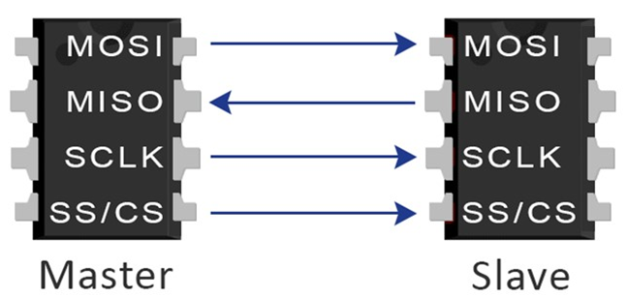
SPI Buses
SPI Interface uses four wires for communication.
Hence it is also known as a four-wire serial communication protocol.
MOSI (Master Out-Slave In)
MISO (Master In-Slave Out)
SCLK (Serial Clock, which produces by the master)
SS (Slave select or Chip select line which is used to select specific slave during the communication)

Slide 34
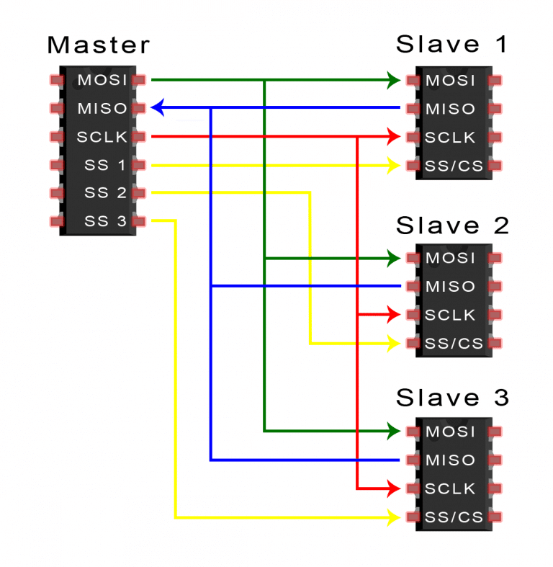
SPI Pins
Pin Name: MOSI
The MOSI signal is a unidirectional signal used for transfer serial data from the Master to the Slave.
When a device is a Master, serial data is output on this signal.
When a device is a Slave, serial data is input on this signal.
Pin Name: MISO
The MISO signal is a unidirectional signal used to transfer serial data from the slave to the master.
When a device is a Slave, serial data is output on this signal.
When a device is a Master, serial data is input on this signal.
When a slave device is not selected, the slave drives the signal with high impedance

Slide 35
SPI Pins
Pin Name: SCLK
Clock signals were utilized by the SPI to synchronize data flow across the SPI Interface.
The frequency of the clock signal controls how quickly information is transferred as one bit of data is sent during each clock cycle.
Clock is only active during the data transfer.
Master device configures and generates the clock signal
Pin Name: SS / CS
The Slave Select or Chip Select line is used to select specific slave during the communication.
Master Device can handle multiple slave devices on the bus by selecting them one by one.
Because the SS line connects each slave with the master, there is no unique address for each slave like for the I2C communication.

Slide 36

SPCR –SPI Control Register
| 7 | 6 | 5 | 4 | 3 | 2 | 1 | 0 |
| SPIE | SPE | DORD | MSTR | CPOL | CPHA | SPR1 | SPR0 |
SPIE - Enables the SPI interrupt when 1
SPE - Enables the SPI when 1
DORD - Sends data least Significant Bit First when 1, most Significant Bit first when 0
MSTR - Sets the Arduino in controller mode when 1, peripheral mode when 0
CPOL - Sets the data clock to be idle when high if set to 1, idle when low if set to 0
CPHA - Samples data on the falling edge of the data clock when 1, rising edge when 0
SPR1 and SPR0 - Sets the SPI speed
00 is fastest (4MHz)
11 is slowest (250KHz)

Slide 37
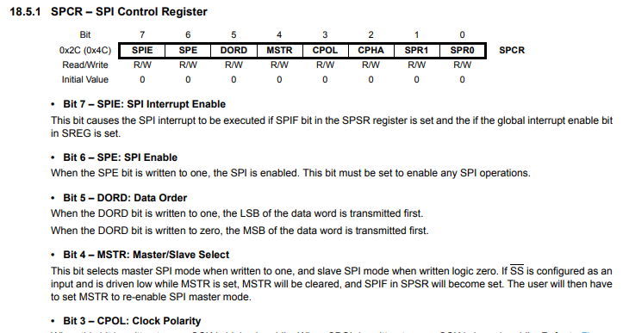
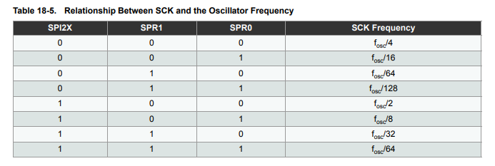
Datasheet – ATMEGA328P
_BV Macro :
_BV(SPE) is a macro that shifts the bit position of the SPE constant to create a bitmask.
It stands for Bit Value and is defined as:
#define _BV(bit) (1 << (bit))
For SPE, which corresponds to bit 6, _BV(SPE) results in 0b01000000.

Slide 38
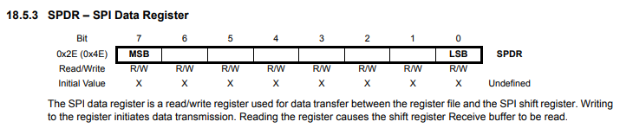
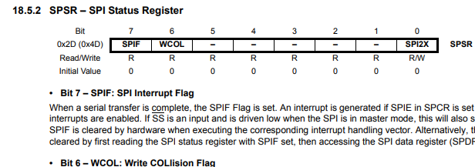
Datasheet – ATMEGA328P
ATMEGA328P Registers :

Slide 39
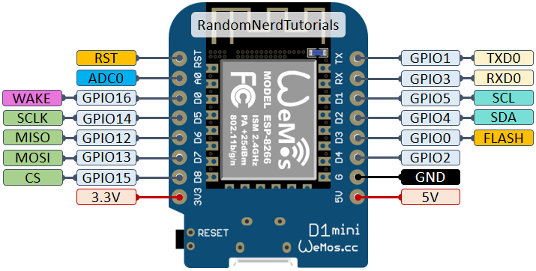
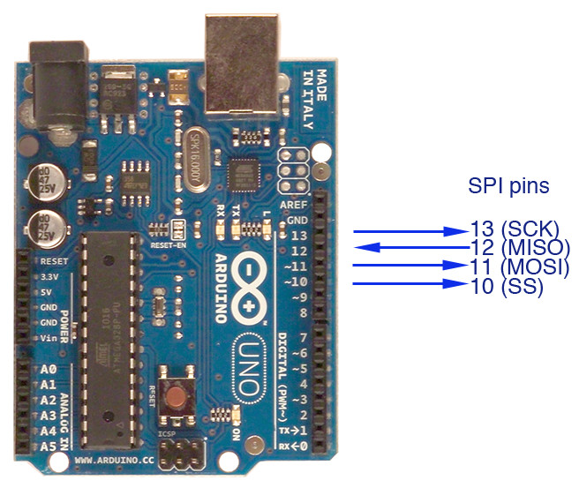
Arduino SPI

Slide 40
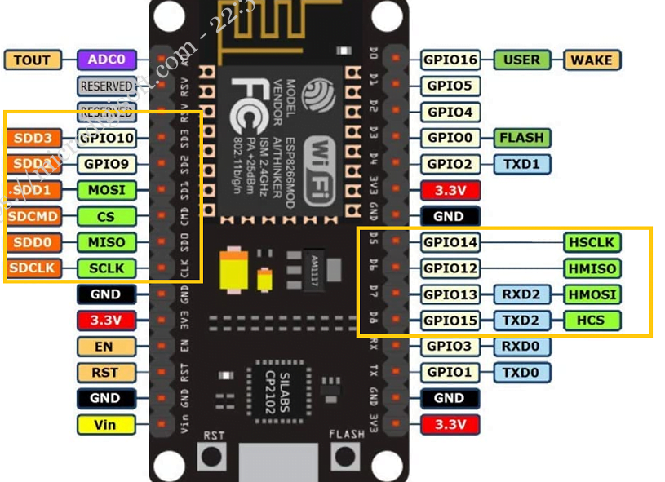
NodeMCU SPI

Slide 41
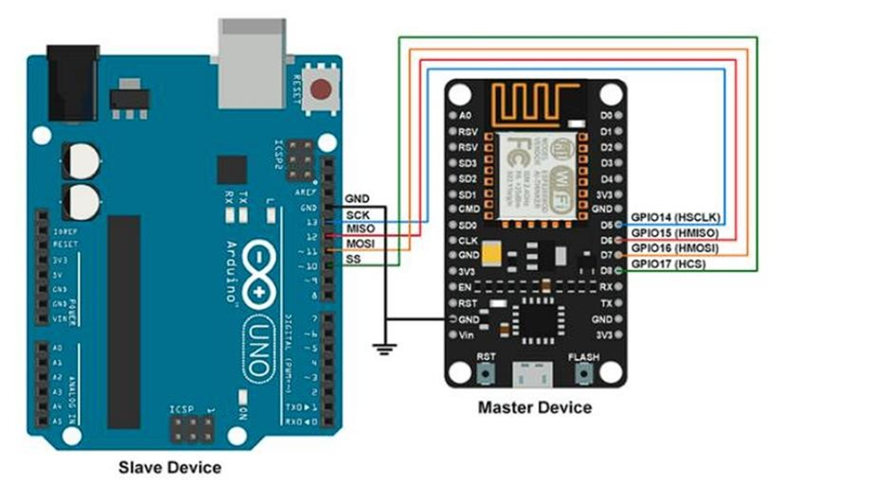
Node MCU – Arduino UNO

Slide 42
SPI Header File
#include<SPI.h>
SPI.begin()
Initializes the SPI bus by setting SCK, MOSI, and SS to outputs, pulling SCK and MOSI low, and SS high.
SPI.begin ();
SPI.setClockDivider(divider)
To set the SPI clock divider relative to the system clock.
On AVR based boards, the dividers available are 2, 4, 8, 16, 32, 64 or 128.
The default setting is SPI_CLOCK_DIV4, which sets the SPI clock to one-quarter of the frequency of the system clock (5 Mhz for the boards at 20 MHz).
Divider − It could be :
SPI_CLOCK_DIV2, SPI_CLOCK_DIV4, SPI_CLOCK_DIV8, SPI_CLOCK_DIV16, SPI_CLOCK_DIV32, SPI_CLOCK_DIV64, SPI_CLOCK_DIV128.

Slide 43
SPI Header File
SPI.transfer(val)
Purpose: Sends and receives a single byte of data over the SPI bus.
The SPI transfer is based on a simultaneous send and receive: the received data is returned in receivedVal.
SPI.transfer(byte data) function sends the byte (data) out via the MOSI pin.
Simultaneously, it reads a byte from the MISO pin.
SPI is a full-duplex protocol, so data is sent and received simultaneously.
byte receivedData;
receivedData = SPI.transfer(0x42); // Send 0x42 and store the received byte

Slide 44
SPI Header File
SPI.attachInterrupt(handler)
Function to be called when a slave device receives data from the master.
SPI.beginTransaction(SPISettings(speedMaximum, dataOrder, dataMode))
The SPISettings object defines the configuration:
Clock speed: Frequency of the SPI clock (e.g., 4000000 for 4 MHz).
dataOrder(MSBFIRST or LSBFIRST) (Master Sends MSB First, Slave sends LSB first)
data mode: Clock polarity and phase (one of SPI_MODE0, SPI_MODE1, SPI_MODE2, SPI_MODE3).
Used for advanced control when dealing with multiple SPI devices that require different configurations.

Slide 45
SPI Mode
Mode 0 (the default) − Clock is normally low (CPOL = 0), and the data is sampled on the transition from low to high (leading edge) (CPHA = 0).
Mode 1 − Clock is normally low (CPOL = 0), and the data is sampled on the transition from high to low (trailing edge) (CPHA = 1).
Mode 2 − Clock is normally high (CPOL = 1), and the data is sampled on the transition from high to low (leading edge) (CPHA = 0).
Mode 3 − Clock is normally high (CPOL = 1), and the data is sampled on the transition from low to high (trailing edge) (CPHA = 1).
SPI.endTransaction()
Purpose: Ends the SPI transaction started by SPI.beginTransaction().
SPI.end()
Purpose: Disables the SPI bus.

Slide 46
NodeMCU (Master Device Code)
Master.ino
1
2
3
4
5
6
7
8
9
10
11
12
13
#include <SPI.h>
void setup (void)
{
Serial.begin(115200);
//set baud rate to 115200 for usart
digitalWrite(SS, HIGH);
// disable Slave Select
SPI.begin ();
SPI.setClockDivider(SPI_CLOCK_DIV8);
//divide the clock by 8 }

Slide 47
NodeMCU (Master Device Code)
Master.ino
14
15
16
17
18
19
20
21
22
23
24
25
26
void loop (void) {
char c;
digitalWrite(SS, LOW);
// enable Slave Select
// send test string
for (const char * p = "Hello, world!\r" ; c = *p; p++) { SPI.transfer (c);
Serial.print(c);
}
digitalWrite(SS, HIGH); // disable Slave Select delay(2000);
}

Slide 48
Arduino UNO (Slave Device Code)
Slave.ino
1
2
3
4
5
6
7
8
9
10
11
12
13
14
#include <SPI.h>
char buff [50];
volatile byte indx;
volatile boolean process;
void setup (void) {
Serial.begin (115200);
pinMode(MISO, OUTPUT);
// have to send on master in so it set as output SPCR |= _BV(SPE);
// turn on SPI in slave mode
indx = 0; // buffer empty
process = false;
SPI.attachInterrupt(); // turn on interrupt }

Slide 49
Arduino UNO (Slave Device Code)
Slave.ino
15
16
17
18
19
20
21
22
23
24
25
26
27
28
ISR (SPI_STC_vect) // SPI interrupt routine
{
byte c = SPDR;
// read byte from SPI Data Register
if (indx < sizeof (buff))
{
buff [indx++] = c;
// save data in the next index in the array buff
if (c == '\r')
//check for the end of the word
process = true; }
}

Slide 50
Arduino UNO (Slave Device Code)
Slave.ino
29
3031
32
33
34
35
36
37
38
39
40
41
42
void loop (void) {
if (process) {
process = false;
//reset the process
Serial.println (buff);
//print the array on serial monitor
indx= 0; //reset buffer index to zero }
}

Slide 51
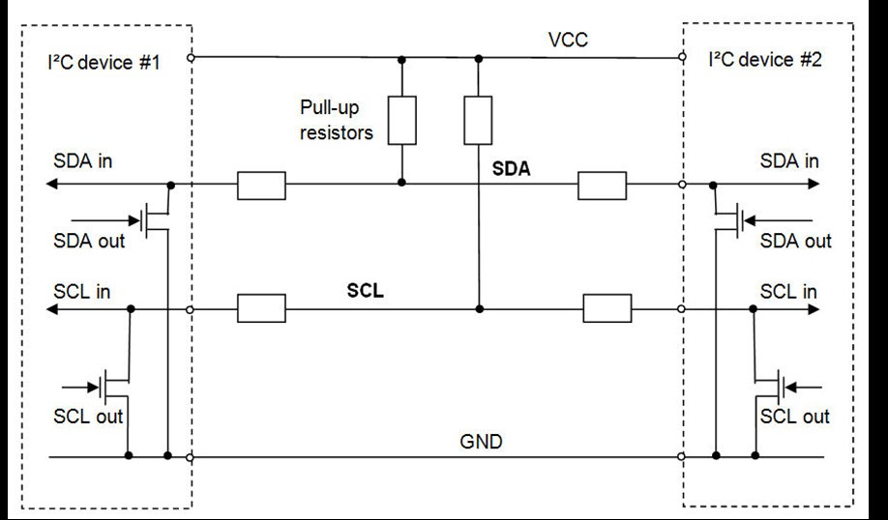
I2C Protocol :Inter Integrated Circuit
One of the widely used Serial Communication protocols, created by Philips Semiconductor in 1982 (Now it is NXP Semiconductor)
Only two communication lines for all devices on the bus (SDA, SCL).
Bi-directional communication
I2C link is half-duplex, means only one device transmits at any given time.
Allows for multiple controllers and multiple targets
Both the signal lines (SDA, SCL) are ‘open drain’, thus pull-up resistors are needed.

Slide 52
I2C Communication Modes
I2C Mode
Speed
Similar in implementation, with different timing requirements
Standard Mode
100
kbps
Fast Mode
400
kbps
Fast Mode Plus
1
Mbps
Requires specific controller code for high speed transfer
High Speed Mode
3.4
Mbps
Ultra
-
Fast Mode
5
Mbps

Slide 53
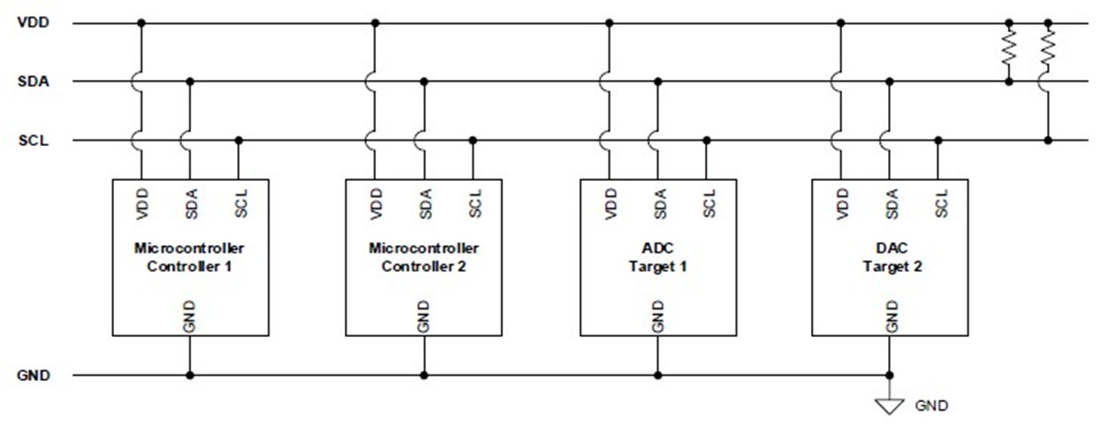
I2C Physical Layer
V_{DD}: Voltage Drain Drain
SDA: Serial Data
SCL: Serial Clock

Slide 54
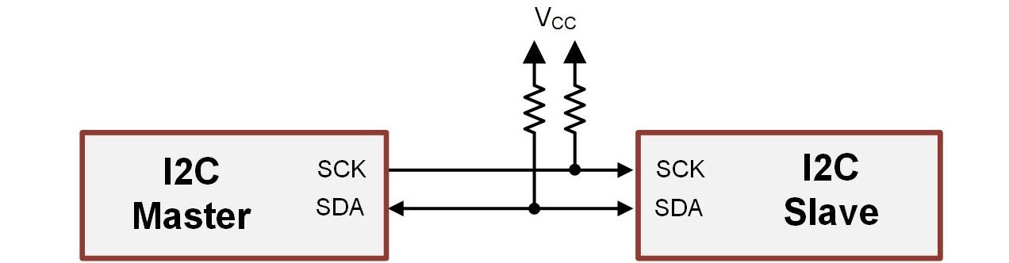
I2C Protocol Operation
Master device – the device that initiates communication and controls the clock.
Slave device – a device on the bus that is read or written to, but does not initiate transmission or provide a clock.
Slave address – a unique and predetermined address for each slave on the bus.
This address is used by the master to indicate which slave it wants to communicate with.
Idle – when both SDA and SCL are held high by the pull-up resistors and no I2C device is attempting to communicate.
Busy – when devices are driving the bus.
Messages – how I2C information is transferred.

Slide 55






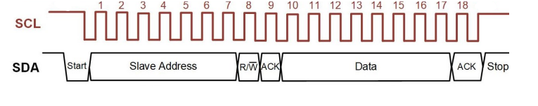
Operation Steps in I2C - 1 to 6
Slave Acknowledgement
No Communication
Read (HIGH)
Write( LOW)
Master Starts
Clock Pulse Numbering
Slave Address
•A master initiates by pulling SDA LOW while SCL is still HIGH.
Master Sends
7bit or 10bit
For the Slave
Each Slave check .
If Addr. Found
Give Ack.
•SCL and SDA both are in Idle
Both master and slave count clock pulse
01
02
03
04
05
06
3
1
2
5
6
4

Slide 56
Operation Steps in I2C - 7 to 09
STOP Condition occurs
Master Proceeds with Data
Data Ack.
•Receiver sends ACK after getting each byte.
•Master checks for Ack. And Proceeds Data
SDA: LOW to HIGH
SCL : Remains HIGH
07
08
09
9
7
8

Slide 57
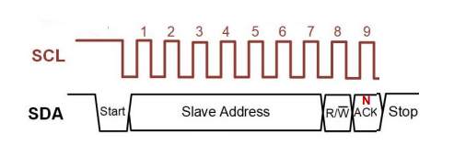
Operation Steps in I2C - 10
NACK
When No slave found with Addr.
10
10

Slide 58
Data Transfer Structure
General structure of a 2-byte transfer
Writing 2-bytes (shaded bits are put on the bus by the master)
Reading 2-bytes (shaded bits are put on the bus by the master)

Slide 59
Wire Library
This Wire library allows you to communicate with I2C/TWI devices
There are both 7 or 8-bit versions of I2C addresses. 7 bits identify the device, and the 8 th bit determines if it’s being written to or read from.
The Wire library uses 7 bit addresses throughout. However, the addresses from 0 to 7 are not used because are reserved so the first address that can be used is 8.
Functions in Wire.h :
begin() | end()
requestFrom() | beginTransmission()
endTransmission() | write()
available() | read()
setClock() | onReceive()
onRequest() | setWireTimeout()
clearWireTimeoutFlag() | getWireTimeoutFlag()

Slide 60
NodeMCU (Master Device Code)
Master-I2C.ino
1
2
3
4
5
6
7
8
9
10
11
1213
14
15
#include <Wire.h>
void setup() {
Serial.begin(9600);
/* begin serial for debug */
Wire.begin(D1, D2);
/* join i2c bus with SDA=D1 and SCL=D2 of NodeMCU */
}
void loop() {
Wire.beginTransmission(8);
/* begin with device address 8 */

Slide 61
NodeMCU (Master Device Code)
Master-I2C.ino
16
17
18
19
20
21
22
23
24
25
26
27
28
29
30
Wire.write("Hello Arduino");
/* sends hello string */
Wire.endTransmission();
/* stop transmitting */
Wire.requestFrom(8, 13);
/*request&read 13 byte data from slave device #8*/
while(Wire.available()){
char c = Wire.read();
Serial.print(c); }
Serial.println();
delay(1000);
}

Slide 62
Arduino Uno (Slave Device Code)
Slave-I2C.ino
1
2
3
4
5
6
7
8
9
10
11
12
#include <Wire.h>
void setup() {
Wire.begin(8);
/* join i2c bus with address 8 */
Wire.onReceive(receiveEvent);
/* register receive event */
Wire.onRequest(requestEvent);
/* register request event */
Serial.begin(9600); /* start serial for debug */ }

Slide 63
Arduino Uno (Slave Device Code)
Slave-I2C.ino
13
14
15
16
17
18
19
20
21
22
23
24
25
26
void loop() {
delay(100); }
/* function that executes whenever data is received from master */
void receiveEvent(int howMany)
{
while (Wire.available()>0)
{
char c = Wire.read();
/* receive byte as a character */
Serial.print(c);
/* print the character */ }
Serial.println();
/* to newline */
}

Slide 64
Arduino Uno (Slave Device Code)
Slave-I2C.ino
27
28
29
30
31
32
33
34
/* function that executes whenever data is requested from master */
void requestEvent() {
Wire.write("Hello NodeMCU");
/*send string on request */
}

Slide 65
IoT Messaging Protocols
MQTT Protocol
CoAP
AMQP

Slide 66



Messaging Protocols in IoT
Messaging Protocols are very important for the transfer of data in terms of messages.
They are useful for send/receive of a message to/from the cloud in IoT applications.
In the section, two messaging protocols are discussed.
Message Queuing Telemetry Transport (MQTT)
Constrained Application Protocol (CoAP)

Slide 67
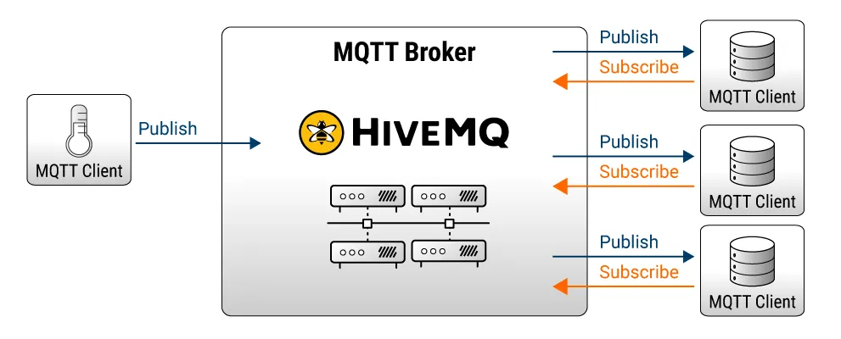
Message Queuing Telemetry Transport (MQTT)
The MQTT full form is Message Queuing Telemetry Transport.
It is a protocol that is mainly used for connecting devices with each other on the internet with backend services.
IoT has one of the biggest challenges of resource constraints, the lightweight protocol is more preferred.
MQTT is widely used in IoT applications as it is a lightweight protocol.
Lightweight means, it can work with minimal resources and does not require any specific hardware architecture or additional resources.

Slide 68
MQTT : Message Queueing Telemetry Transport protocol
It’s Reliable, Lightweight, Cost-effective protocol that transports messages between devices.
Suited for the transport of telemetry data (sensor and actuator data)
MQTT is a machine-to-machine connectivity protocol that runs over TCP/IP.
MQTT is based on a publish- subscribe structure.
Publish : A Publisher sends messages according to Topics, to specified Brokers.
Broker : A Broker acts as a switchboard, accepting messages from publishers on specified topics, and sending them to subscribers to those Topics.
Subscribe : A Subscriber receives messages from connected Brokers and specified Topics.
MQTT is an Event based IoT middleware (one to many).
It can be supported by some of the smallest measuring and monitoring devices (ex. Arduino).

Slide 69
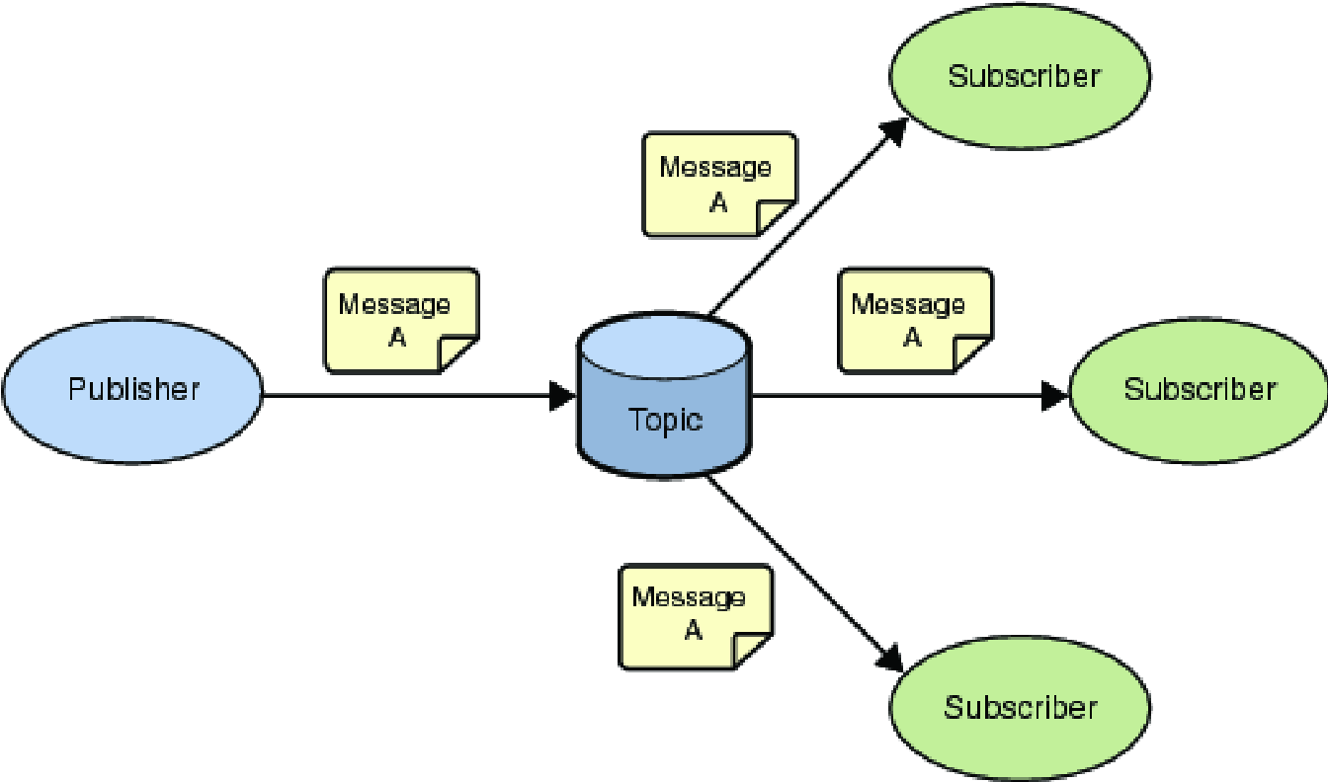
Publish / Subscribe Messaging (One to Many)
A producer publishes a message (publication) on a topic (subject).
A consumer subscribes (makes a subscription) for messages on a topic (subject).
A message server (called Broker) matches publications to subscriptions
Publish / Subscribe has three important characteristics:
It decouples senders and receivers, allowing for more flexible applications.
It can take a single message and distribute it to many consumers.
This collection of consumers can change over time, and vary based on the nature of the message.
Server

Slide 70
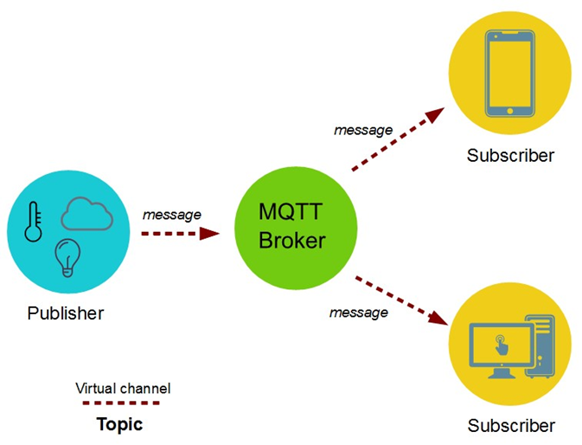
MQTT Architecture
Architecture of MQTT:
Publisher
Broker
Subscribers

Slide 71
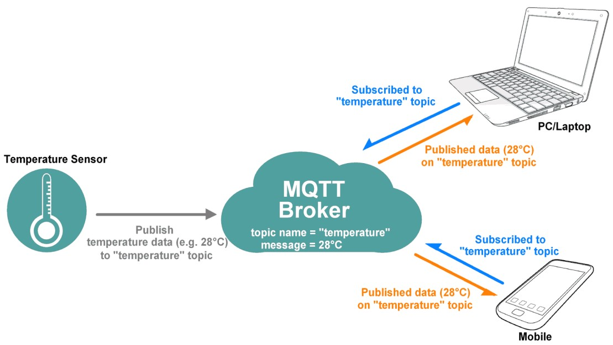
MQTT Communication
Who will get the message ?
If no matches, the message is discarded
If one / more matches, the message is delivered to each matching subscriber/consumer
Asynchronous communication model with messages (events).
Publisher and Subscriber need not be online at the same time.

Slide 72
MQTT Topic
A topic forms the namespace
Is hierarchical with each “sub topic” separated by a: Forwardslash /
An example:
A house publishes information about itself on:
<country>/<state>/<town>/<postcode>/<house>/energyConsumption
<country>/<state>/<town>/<postcode>/<house>/solarEnerg
<country>/<state>/<town>/<postcode>/<house>/alarmState
And subscribes for control commands:
<country>/<state>/<town>/<postcode>/<house>/thermostat/setTemp

Slide 73
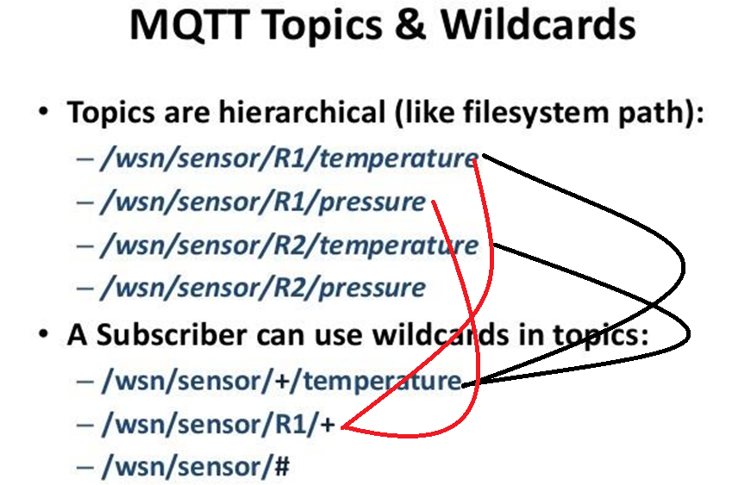
MQTT Subscriber
A subscriber can subscribe to an absolute topic or can use wildcards:
Single-level wildcards “+” can appear anywhere in the topic string
Multi-level wildcards “#” must appear at the end of the string
Wildcards must be next to a separator
Cannot be used wildcards when publishing

Slide 74
Subscription types
A subscription can be durable or non-durable
Durable:
Once a subscription is in place, A broker will forward matching messages to the subscriber immediately if the subscriber is connected.
If the subscriber is not connected, messages are stored on the server/broker until the next time the subscriber connects.
Non-durable / Transient (i.e. subscription ends with client session):
The subscription lifetime is the same as the time the subscriber is connected to the server / broker.
Messages are not stored on the server/broker.

Slide 75
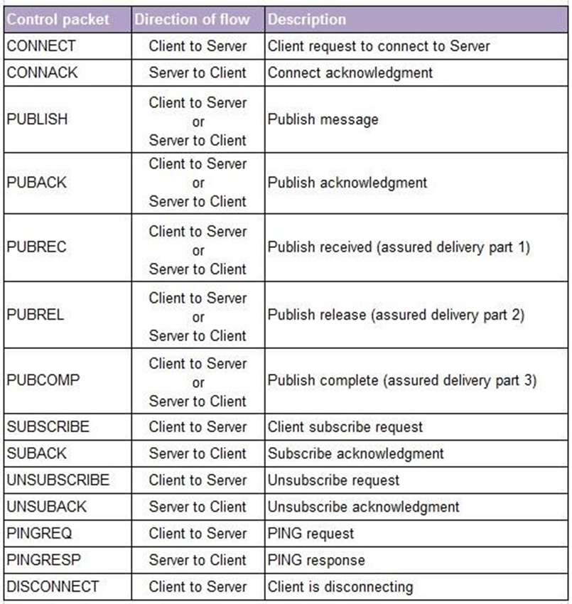
MQTT publish-subscribe architecture :Control packet
The MQTT messages are delivered asynchronously (“push”) through publish subscribe architecture.
The MQTT protocol works by exchanging a series of MQTT control packets in a defined way.
Each control packet has a specific purpose and every bit in the packet is carefully crafted to reduce the data transmitted over the network.
A MQTT topology has a MQTT server and a MQTT client
MQTT client and server communicate through different control packets.

Slide 76

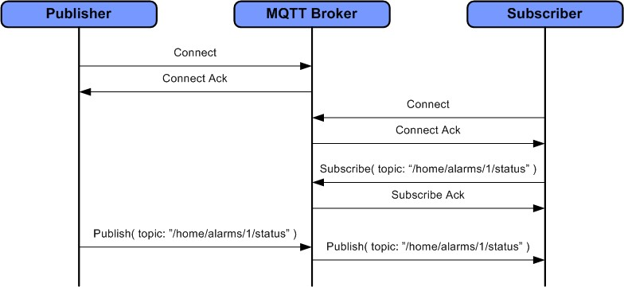
MQTT Communication Sample:

Slide 77




MQTT – Example
Suppose a temperature sensor is connected to any system and we want to monitor that temperature.
The controller connected to the temperature sensor publishes the temperature value to the MQTT broker with a topic name: “Temperature”. Hence, it is considered a publisher.
The MQTT broker transmits the temperature value to the subscribers.
Note : The only Nodes which have subscribed to the topic
Will capture the data and not the other nodes.
Subscriber 1
Subscribed to:
“Temperature”
Subscriber 2
Publisher
MQTT Broker
Subscribed to:
“Temperature”
Subscriber 3

Slide 78


MQTT - Example
Can publisher and subscriber interchange their role?
Let us take an example of a Driverless car.
A GPS sensor is connected to the car which gives the current location of the car.
The system in car, publishes the location to MQTT broker with topic name – CurrentLocation.
The server/computer subscribes to the topic CurrentLocation and receives the current location of the car.
Publisher: CurrentLocation
MQTT Broker
Subscriber: CurrentLocation

Slide 79
MQTT - Example
Based on the currently selected destination, the server/computer computes the direction of the car.
This data is published to an MQTT broker with a topic named – Direction.
To get the command from the server, the system in the car has to subscribe to the topic named Direction.
According to the command received from the server, the car will run in particular direction.
Publisher: CurrentLocation
MQTT Broker
Subscriber: CurrentLocation
Subscriber: Direction
Publisher: Direction

Slide 80


MQTT - Working
In MQTT, clients do not have any address like a typical networking scheme.
The broker filters the messages based on the subscribed topics.
The messages will then be circulated to respective subscribers.
The topic name can be anything in string format.
The MQTT working can be explained with an example of the television broadcast.
Client_Address

Slide 81





MQTT - Working
Television broadcaster station broadcasts all the channels.
The viewers subscribe to their favorite channels only.
Similarly, in MQTT, the publisher node publishes data with the topic name and interested subscribers subscribe to the topic.
Note that there can be multiple subscribers of a same topic as well as a single subscriber can be subscribe to multiple topics.

Slide 82

MQTT – Node(s)
Node(s) in MQTT collects the information from sensors or other input devices in case of the publisher.
Connects it to the messaging server known as the MQTT broker.
A specific string – Topic is used to publish the message.
Let other nodes understand the topic. These nodes are considered subscribers.
Any Node can be publisher or subscriber and node is also referred to as client.
Publisher
MQTT
Broker
Subscriber
Topic:SensData
Topic

Slide 83
Quality of Service (QoS) for MQTT
Quality of service (QoS) levels determine how each MQTT message is delivered and must be specified for every message sent through MQTT.
Three QoS for message delivery could be achieved using MQTT:
QoS 0 = (At most once) - where messages are delivered according to the best efforts of the operating environment. Message loss can occur.
QoS 1 = (At least once) - where messages are assured to arrive but duplicates can occur.
QoS 2 = (Exactly once) - where message are assured to arrive exactly once.
There is a simple rule when considering performance impact of QoS :
“The higher the QoS, the lower the performance".

Slide 84
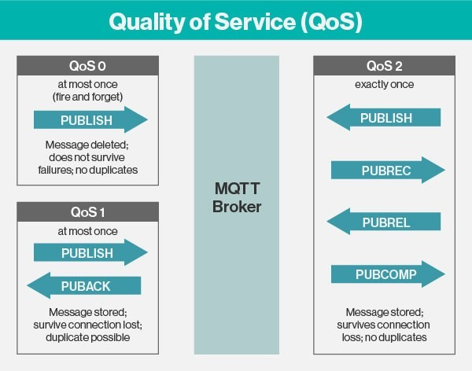
QoS : Quality of Service

Slide 85
QoS - 0
Publisher
Broker
Subscriber
Publish (QoS = 0)
Publish
Delete message

Slide 86
QoS - 1
Publisher
Broker
Subscriber
Store Message
Publish (QoS = 1)
Store Message
Publish
Delete message
PUBACK
Delete message

Slide 87
QoS - 2
Publisher
Broker
Subscriber
Store Message
Publish (QoS = 2)
Store Message
Publish
PUBREC
PUBREL
Delete message
PUBCOMP
Delete message

Slide 88
MQTT Clients and APIs
You can develop an MQTT client application by programming directly to the MQTT protocol specification …… however it is more convenient to use a prebuilt client
Open Source clients available in Eclipse Paho project : Languages : C, C++, Java, JavaScript, Lua, Python and Go.
Clients for other languages are available, see mqtt.org/software. E.g. Delphi, Erlang, .Net, Objective-C, PERL, PHP, Ruby.
Not all of the client libraries listed on mqtt.org are current. Some are at an early or experimental stage of development, whilst others are stable and mature.

Slide 89
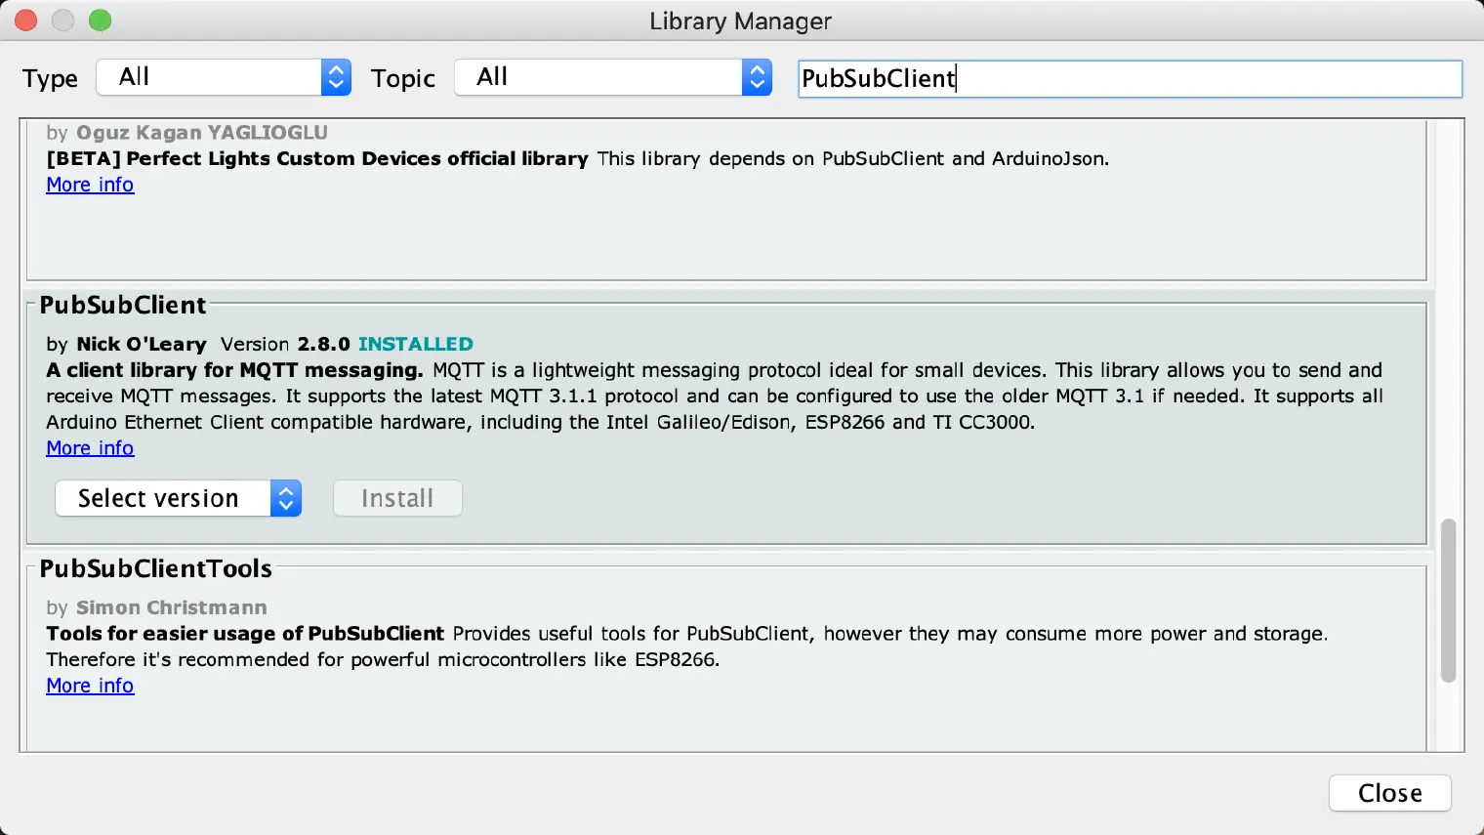
Arduino IDE : ESP8266 + MQTT
Library : PubSubClient by Nick O’Leary

Slide 90
MQTT Publisher – Code Implementation
The code for MQTT publisher is as shown in below.
Including the “ESP8266WiFi” library for enabling Wi-Fi connection with protocols.
MQTT_publisher.ino
1
2
3
4
5
6
7
8
9
10
11
12
13
#include <ESP8266WiFi.h>
#include <PubSubClient.h>
const char* ssid = “IoT_Demo";
const char* pwd = “diet@iot";
const char* mqtt_server =
"broker.mqtt-dashboard.com";
WiFiClient espClient;
PubSubClient client(espClient);
int value = 0;
unsigned long lastMsg = 0;
#define MSG_BUFFER_SIZE (50)
char msg[MSG_BUFFER_SIZE];
Including the “PubSubClient” library for use of MQTT protocol and their functions.
Defining parameters for Wi-Fi connection.
Defining MQTT server/broker for publishing the message on particular topic.

Slide 91
MQTT Publisher – Code Implementation
MQTT_publisher.ino
14
15
16
17
18
19
20
21
22
23
24
25
26
27
28
29
30
void setup_wifi() {
delay(10);
Serial.println();
Serial.print("Connecting to ");
Serial.println(ssid);
WiFi.mode(WIFI_STA);
WiFi.begin(ssid, pwd);
while(WiFi.status()!=WL_CONNECTED) {
delay(500);
Serial.print(".");
} Serial.println("WiFi connected");
Serial.println("IP address: ");
Serial.println(WiFi.localIP());
}
Initializing Wi-Fi module as station mode.
Connecting Wi-Fi module with given SSID and Password
Try until Wi-Fi is not connected to given SSID with delay of half second.

Slide 92
MQTT Publisher – Code Implementation
MQTT_publisher.ino
Connects the client to the MQTT Server stored in mqtt_server with port number 1883.
31
32
33
34
35
36
37
38
39
40
41
42
43
void setup() {
Serial.begin(115200);
setup_wifi();
client.setServer(mqtt_server,1883);
while (!client.connected()) {
Serial.print("Attempting MQTT");
String clientId="ESPClient1234";
if (client.connect(
clientId.c_str())) {
Serial.println("connected");
client.publish(“darshan/6thsem/ce", “You are in Darshan");
}
}
}
Execute the syntax in loop until ESP is not connected to MQTT broker.
Defining a clientId for MQTT server/broker.
Returns the pointer of string clientId to the array.
Publishing announcement message after connecting to the MQTT broker with Topic name : darshan/6thsem/ce

Slide 93
MQTT Publisher – Code Implementation
MQTT_publisher.ino
44
45
46
47
48
49
50
51
52
53
54
55
56
57
58
void loop() {
client.loop();
unsigned long now = millis();
if (now - lastMsg > 2000)
{
lastMsg = now;
++value;
snprintf (msg, MSG_BUFFER_SIZE,"hello world #%ld", value);
Serial.print("Publish message:");
Serial.println(msg);
client.publish("darshan/6thsem/ce", msg);
}
}
This function allows client to process incoming messages, publish data and refresh the connection.
Creating a string in msg with given buffer size and assigning the value “hello world” with concatenation of integer named value.
Publishes the msg in the given topic name: darshan/6thsem/ce

Slide 94
MQTT Subscriber – Code Implementation
The code for MQTT subscriber is as shown in below.
MQTT_subscriber.ino
Including the “ESP8266WiFi” library for enabling Wi-Fi connection with protocols.
1
2
3
4
5
6
7
8
9
#include <ESP8266WiFi.h>
#include <PubSubClient.h>
const char* ssid = “IoT_Demo";
const char* pwd = “diet@iot";
const char* mqtt_server =
"broker.mqtt-dashboard.com";
WiFiClient espClient;
PubSubClient client(espClient);
Including the “PubSubClient” library for use of MQTT protocol and their functions.
Defining parameters for Wi-Fi connection.
Defining MQTT server/broker for publishing the message on particular topic.

Slide 95
MQTT Subscriber – Code Implementation
MQTT_subscriber.ino
10
11
12
13
14
15
16
17
18
19
20
21
22
23
24
25
26
void setup_wifi() {
delay(10);
Serial.println();
Serial.print("Connecting to ");
Serial.println(ssid);
WiFi.mode(WIFI_STA);
WiFi.begin(ssid, pwd);
while(WiFi.status()!=WL_CONNECTED) {
delay(500);
Serial.print(".");
} Serial.println("WiFi connected");
Serial.println("IP address: ");
Serial.println(WiFi.localIP());
}
Initializing Wi-Fi module as station mode.
Connecting Wi-Fi module with given SSID and Password
Try until Wi-Fi is not connected to given SSID with delay of half second.

Slide 96
MQTT Subscriber – Code Implementation
MQTT_subscriber.ino
27
28
29
30
31
32
33
34
35
36
37
void callback(char* topic,
byte* payload, unsigned int length) {
Serial.print("Message arrived [");
Serial.print(topic);
Serial.print("] ");
for (int i = 0; i < length; i++)
{
Serial.print((char)payload[i]);
}
Serial.println();
}
A callback function for receiving messages every time when client.loop( ) executes.
This function accepts the arguments char* of topic, char* of payload and the length of payload.
Executing the for loop until all the characters of the payload are printed.
Typecasting of payload[i] into equivalent character and then printing on serial monitor.

Slide 97
MQTT Subscriber – Code Implementation
MQTT_subscriber.ino
38
39
40
41
42
43
44
45
46
47
48
49
50
51
52
53
54
void setup() {
Serial.begin(115200);
setup_wifi();
client.setServer(mqtt_server,1883);
client.setCallback(callback);
while (!client.connected()) {
Serial.print("Attempting MQTT");
String clientId="ESPClient1234";
if (client.connect(
clientId.c_str())) {
Serial.println("connected");
client.subscribe("darshan/6thsem/ce");
}
}
}
void loop() {
client.loop(); }
This is built-in function client.setCallback( ) in PubSubClient library and it calls a function callback( ) every time when client.loop( ) function is executed.
Subscribing to the Topic named “darshan/6thsem/ce”

Slide 98
Sensors And Actuators
Sensors and actuators are critical components of Embedded systems.
These are utilized in various real-world applications, including flight control systems in aircraft, process control systems in nuclear reactors, and power plants that require automated control.
Sensors and actuators differ primarily in their purpose; the sensor is utilized to track environmental changes by measurement, whereas the actuator is utilized when monitoring is combined with control, such as controlling physical changes.

Slide 99
Sensors
Sensors: Sensors are the ways of getting information into your device, finding out things about your surroundings.
A sensor is a device that detects changes and events in a physical environment.
It may convert physical parameters like humidity, pressure, temperature, heat, motion, etc., into electrical signals.
Electrical signal can be converted into a human-readable display and sent across a network for additional processing.
Types of Sensor (Based on power requirement) :
Active sensors
Passive sensors.
Active sensors necessitate a power supply, whereas passive sensors don't require a power supply.

Slide 100



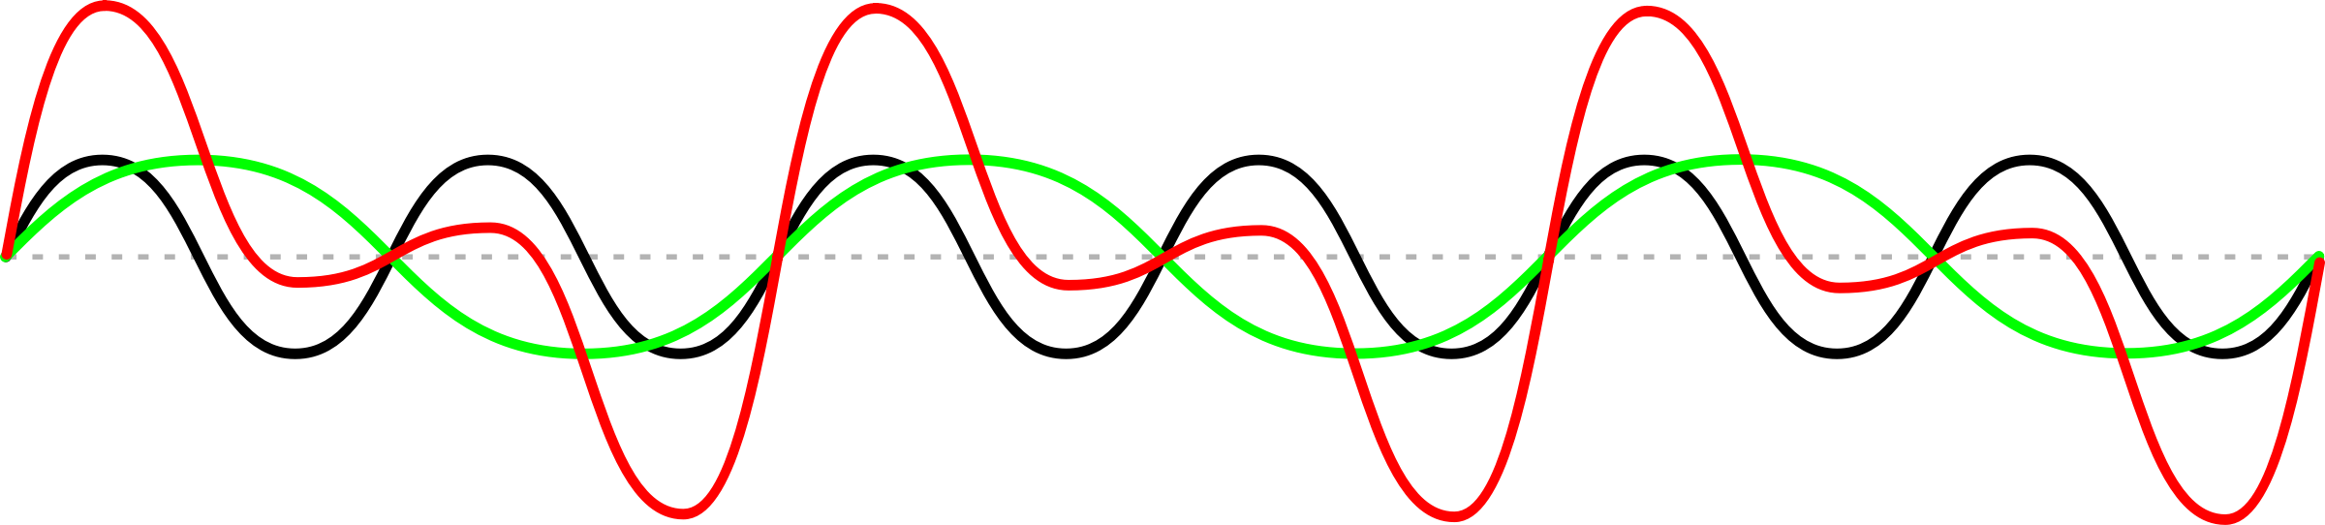
Sensors Functionality
Conversion
Sensor

Slide 101
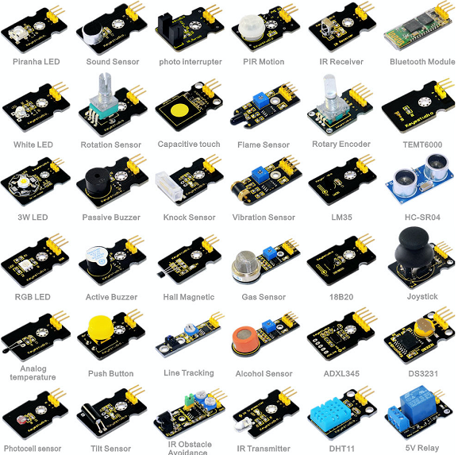
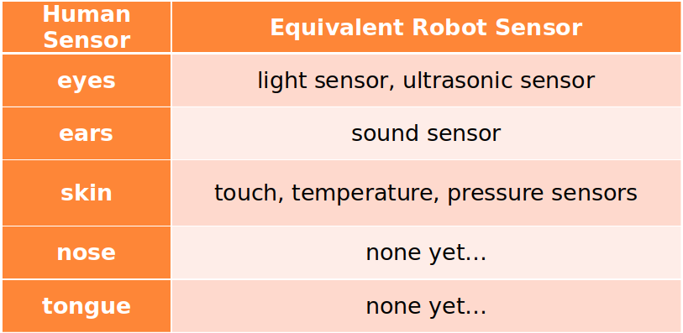
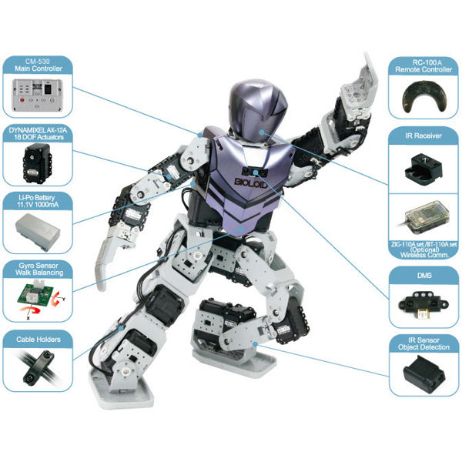
Sensors

Slide 102
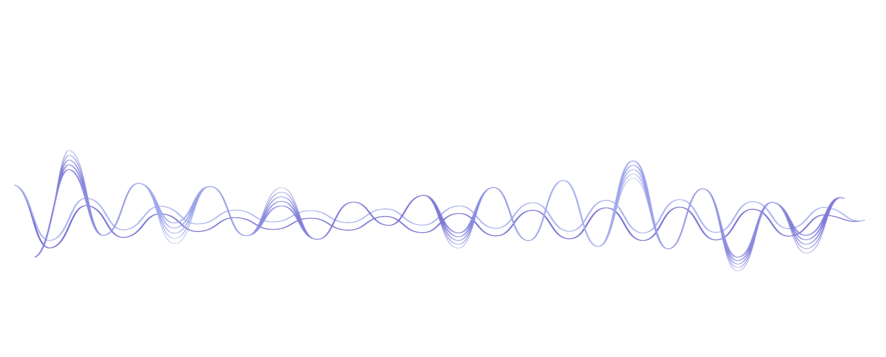
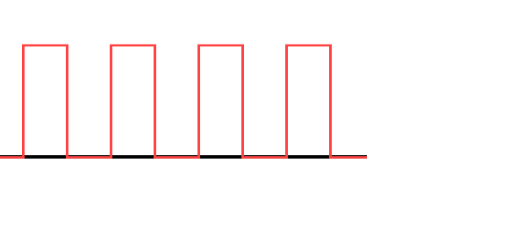
Sensors Types (Based on Sensor’s Output Signal)
The sensors are input devices and there are two types of sensors.
Analog Sensors : Generates Analog output Voltage.
Digital Sensors : Generates Digital output Voltage

Slide 103
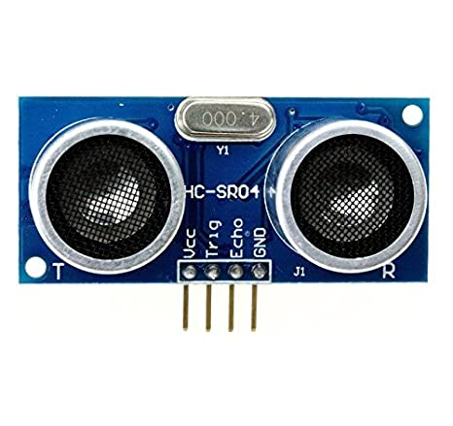
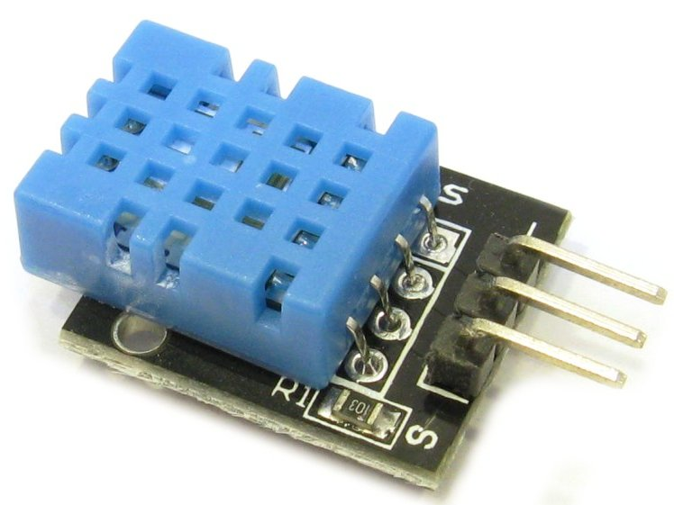
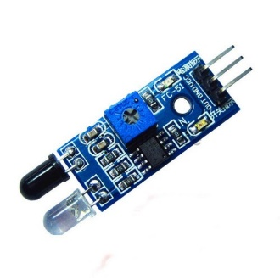

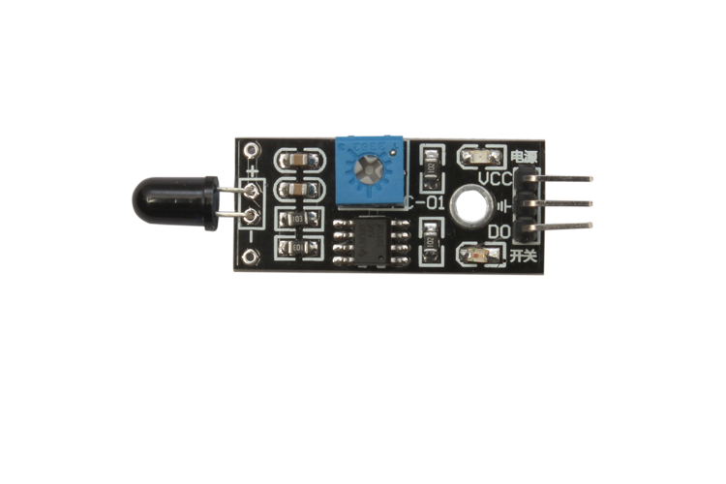
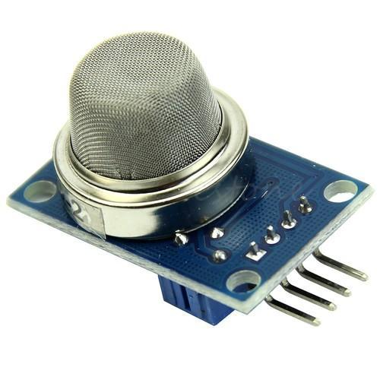
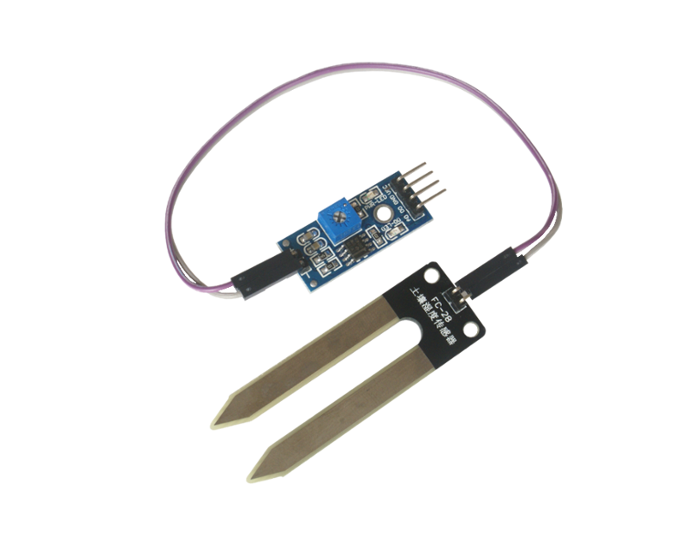


Sensors
Ultrasonic Distance Sensor
Temperature and Humidity Sensor
Obstacle Sensor
Flame Sensor
MQ-02/05 Gas Sensor
LDR Sensor
Heartbeat Sensor
Soil Moisture Sensor

Slide 104
Sensor and Sensor Module
LDR
Gas Sensor
Obstacle Sensor
Ultrasonic Sound Distance measurement module
Heartbeat sensor
GPS Module & PH Sensor
Color Sensor

Slide 105


LDR Sensor
LDR is known as Light Dependent Resistor.
The internal resistance of LDR changes with respect to light intensity.
Normally LDR works with voltage divider network.
The LDR is used in the application where the task is performed with light intensity as input.

Slide 106




LDR Sensor – Working principle
As the light intensity on LDR is higher, the resistance of LDR decreases.
The decreased resistance will drop more voltage across LDR according to Ohm’s Law.
The presence of light can be identified by the value of voltage across LDR.
Light Intensity to be measured
Output voltage measurement
Calculate the intensity

Slide 107

LDR Sensor– Interfacing with Arduino
The interfacing of LDR sensor with Arduino Uno is as shown in figure.
Here, one terminal of 10kΩ resistor is connected to 5V of Arduino and second terminal is connected to A0 pin.
One terminal of LDR is connected to A0 pin of Arduino and other is connected to Gnd.
This creates a voltage divider network between fixed resistor and LDR.
The voltage at A0 pin remains near to 5V when LDR is in dark (high resistance).
The voltage at A0 pin remains near to 0V when LDR is in Bright light (low resistance).

Slide 108
LDR Sensor – Code explanation
Light-intensity-measure.ino
1
2
3
4
5
6
7
8
9
10
11
12
13
14
15
16
17
void setup()
{
pinMode(A0, INPUT);
Serial.begin(9600);
}
void loop()
{
int light_intensity = analogRead(A0);
if (light_intensity > 750)
{
Serial.println(“Darker"); }
else if (light_intensity < 400)
{
Serial.println(“Too Bright"); }
delay(1000);
}

Slide 109




LDR Sensor – Output

Slide 110

Gas Sensor : MQ-02/05
MQ -02 sensor is used to detect smoke.
H2, LPG, CH4 alcohol and smoke can be detected by MQ-02.
MQ-05 is not sensitive to smoke, hence less used in the application.
Pin-out of MQ-02
Vcc – Connected to 5V
Gnd – Connected to ground
DO – Digital output pin
AO - Analog Outout pin

Slide 111


MQ Series Sensor
MQ-2 - Methane, Butane, LPG, smoke
MQ-3 - Alcohol, Ethanol, smoke
MQ-4 - Methane, CNG Gas
MQ-5 - Natural gas, LPG
MQ-6 - LPG, butane gas
MQ-7 - Carbon Monoxide
MQ-8 - Hydrogen Gas
MQ-9 - Carbon Monoxide, flammable gasses
MQ131 - Ozone
MQ135 - Air Quality (CO, Ammonia, Benzene, Alcohol, smoke)
MQ136 - Hydrogen Sulphide gas
MQ137 - Ammonia
MQ138 - Benzene, Toluene, Alcohol, Acetone, Propane, Formaldehyde gas, Hydrogen
MQ214 - Methane, Natural gas

Slide 112



MQ-02/05 Gas Sensor – Working principle
When any flammable gas passes through the coil of the sensor, the coil burns and Internal Resistance Decreases.
This results in an Increased Voltage across it. Hence we get variable voltage at Analog Out (A0) pin of MQ-05 gas sensor.
If gas present -> voltage is high.
Smoke/Gas
MQ-05 Gas Sensor
Variable Voltage

Slide 113


MQ-02/05 Gas Sensor – Interfacing with Arduino
The interfacing of MQ-02 with Arduino Uno is as shown in the figure.
Here, Vcc and Gnd pins of MQ-02 are connected to 5V and GND of Arduino board.
We want to take the input from a Gas sensor in an analog signal.

Slide 114
MQ-02/05 Gas Sensor – Code With Explanation
Initialize the serial communication between Arduino and computer with baud rate 9600.
gas_sensor.ino
1
2
3
4
5
6
7
8
9
10
11
12
int gas_level;
void setup() {
pinMode(A0, INPUT);
Serial.begin(9600);
}
void loop() {
gas_level = analogRead(A0);
Serial.print("Gas Level : ");
Serial.println(gas_level);
delay(500);
}
Reads the analog value from specified pin and stores it in the mentioned variable.
Prints data on the serial port in ASCII text given in double quotes.
Prints the data of specified variable on the serial port and also prints new line at the end.

Slide 115




MQ-02/05 Gas Sensor – Output

Slide 116


Obstacle Sensor
Obstacle sensor is used for detection of obstacle.
It is a digital sensor, hence gives binary output ‘1’ or ‘0’.
The range for detection of obstacle can be changed by potentiometer given.
Pin-out :
Vcc – Connected to 5V
Gnd – Connected to ground
Out - Output pin (Digital)

Slide 117



Obstacle Sensor – Working principle
IR emitter transmits IR signals and IR receiver receives those signals from reflection.
If the obstacle is present then the transmitted signals are reflected back by obstacle and if they have amplitude greater then threshold the output signal will be ‘0’.
If the obstacle is not present then the transmitted signals are not reflected and the output signal will be ‘1’.
Obstacle in the way
Obstacle IR Sensor
Digital Output

Slide 118
Obstacle Sensor – Interfacing with Arduino
The interfacing of obstacle sensor with Arduino Uno is as shown in figure.
Here, Vcc and Gnd pins of obstacle sensor is connected to 5V and Gnd of Arduino board.
The output of obstacle sensor is in digital signal.

Slide 119
Obstacle Sensor – Code explanation
obstacle-detect.ino
1
2
3
4
5
6
7
8
9
10
11
12
13
14
15
16
17
int obstacle_pres=0;
void setup() {
pinMode(2, INPUT);
pinMode(13, OUTPUT);
Serial.begin(9600);
}
void loop() {
obstacle_pres = digitalRead(2);
if (obstacle_pres == LOW)
{
Serial.print("Obstacle is present");
digitalWrite(13,HIGH);}
else{
digitalWrite(13,LOW);}
delay(1000);
}
Reads the digital data from specified pin and stores it into given variable.

Slide 120
HC-SR04 Ultrasonic Sound Sensor
Ultrasonic Sound Sensor is used to measure the distance of an object.
The sensor can only measure the distance of object. It can not identify the type of object.
It is also known as Ultrasonic distance sensor.
Pin-out of HC-SR04 module are
Vcc – Connected to 5V
Gnd – Connected to ground
Trigger – Generates the transmit pulse
Echo – Receives echo from obstacle

Slide 121
HC-SR04 Ultrasonic Sound Sensor– Interfacing with Arduino
The interfacing of HC-SR04 sensor with Arduino Uno is as shown in figure.
Vcc and Gnd pins of HC-SR04 sensor are connected to 5V and Gnd of Arduino board.
The Trigger and Echo pin is connected to (any) digital pins of Arduino board.
In this case, trigger is connected to 11 and echo is connected to 12.

Slide 122
HC-SR04
The sensor is composed of two ultrasonic transducers.
One is transmitter which outputs ultrasonic sound pulses and the other is receiver which listens for reflected waves.
The HC-SR04 Ultrasonic Range Sensor Features:
Input Voltage: 5V
Current Draw: 20mA (Max)
Digital Output: 5V
Digital Output: 0V (Low)
Working Temperature: -15°C to 70°C
Sensing Angle: 30° Cone
Angle of Effect: 15° Cone
Ultrasonic Frequency: 40kHz
Speed of sound : 343 mtr/sec
Range: 2cm - 400cm (about an inch to 13 feet)
343 * 100 cm
10⁶ μ sec
^{= 0.0343}

Slide 123

HC-SR04 Ultrasonic Sound Sensor – Transmitter and Receiver
Ultrasonic Sound Sensor Transmit and Receive Sound wave

Slide 124

HC-SR04 Ultrasonic Sound Sensor – Working principle
When the Trigger Pin is set HIGH for 10µs.
The sensor transmits an ultrasonic burst of eight pulses at 40 kHz.
These 8 ultrasonic pulses travel through the air away from the transmitter.
Meanwhile the echo pin goes HIGH to initiate the echo-back signal.
If those pulses are not reflected back, the echo signal times out and goes low after 38ms (38 milliseconds).
Thus a pulse of 38ms indicates no obstruction within the range of the sensor.

Slide 125

HC-SR04 Ultrasonic Sound Sensor – Working principle

Slide 126

HC-SR04 Ultrasonic Sound Sensor – Working principle
If those pulses are reflected back, the echo pin goes LOW as soon as the signal is received.
This generates a pulse on the echo pin whose width varies from 150 µs to 25 ms depending on the time taken to receive the signal.
The width of the received pulse is used to calculate the distance from the reflected object.

Slide 127
HC-SR04 Ultrasonic Sound Sensor –Timing Diagram
Step 1: Make Trigger Pin High for the 10 µs.
(Module Will Generates the Sound Wave)
Module makes Echo Pin HIGH.
Echo Pin goes LOW, once it received pulse.
Step 2: Get the Value of Time duration, from which ECHO pin HIGH duration.
delayMicroseconds( ): It pauses the program for amount of time in microseconds specified as the parameter.
Syntax : delayMicroseconds(μs)
Parameters : The number of microseconds to pause.
pulseIn( ) : Reads a pulse HIGH or LOW from specified pin and wait for the time to go the pulse from HIGH to LOW or LOW to HIGH. It returns the time required to transit the pulse in variable.
Syntax : pulseIn(pin, value)
Parameters - Pin: The number of the Arduino pin on which you want to read the pulse. - Value: The type of pulse that you want to read.

Slide 128
HC-SR04 Ultrasonic Sound Sensor – Code explanation
The code in Arduino for HC-SR04 Ultrasonic Sound Sensor can be written as following
Distance-measure.ino
1
2
3
4
5
6
7
8
9
10
11
12
13
14
15
int trigPin = 11; // Trigger
int echoPin = 12; // Echo
long duration, cm, inches;
void setup() {
Serial.begin (9600);
pinMode(trigPin, OUTPUT);
pinMode(echoPin, INPUT);
}
void loop() {
digitalWrite(trigPin, LOW);
delayMicroseconds(5);
digitalWrite(trigPin, HIGH);
delayMicroseconds(10);
digitalWrite(trigPin, LOW);
Generates the delay of specified microseconds.
High for 10μSec.

Slide 129
HC-SR04 Ultrasonic Sound Sensor – Code explanation (Cont.)
Distance-measure.ino
Reads a HIGH pulse on specified pin and returns the value of time in microsecond for transition from LOW to HIGH.
16
17
18
19
20
21
22
23
24
25
26
27
28
29
duration = pulseIn(echoPin, HIGH);
// Convert the time into a distance
cm = (duration/2) / 29.1;
inches = (duration/2) / 74;
Serial.print(inches);
Serial.print("in, ");
Serial.print(cm);
Serial.print("cm");
Serial.println();
delay(250);
}
Distance(m) = Speed (m/s)x Time (s)
But, Time of pulse we receive is in µs and distance we want to find is in cm.
Distance(cm) = Speed (cm/µs) x Time (µs)
Speed of sound is 343 mtr/sec which is converted into 0.0343 cm/µs.
So either we have to multiply 0.0343 or divide 29.1

Slide 130




HC-SR04 Ultrasonic Sound Sensor – Output

Slide 131


Heartbeat Sensor
Heartbeat sensor is having typical application in health care domain.
This is mainly used in wearable devices to monitor the heart beat or heart rate of the person.
The sensor is inexpensive and generates square waves for each pulse.
The averaging of pulses gives analog voltage according to the heartbeat.
Pinout of heartbeat sensor module are
Vcc – Connected to 5V
Gnd – Connected to ground
A0 – Analog output pin

Slide 132

Heartbeat Sensor – Interfacing with Arduino
The interfacing of Heartbeat sensor with Arduino Uno is as shown in the figure.
Here, Vcc and Gnd pins of heartbeat sensor are connected to 5V and GND of Arduino board.
We want to take the input from the sensor in an analog format so the signal pin of the sensor is connected to one of the analog pins of Arduino i.e. A0.

Slide 133



Heartbeat Sensor – Working principle
The sensor senses the heartbeat as per blood circulation in the body.
It generates the output pulse signal according to the rate at which heart beats.
The output pulses are considered as PWM waves. Hence they are converted into analog signals.
This analog signal is converted to digital which gives the output beat rate.
Heartbeat input
Generation of Digital Pulse
as output
Calculates the BPM

Slide 134


Heartbeat Sensor – Working principle
When a heartbeat occurs, blood is pumped through the human body and gets squeezed into the capillary tissues.
Consequently, the volume of these capillary tissues increases.
But in between the two consecutive heartbeats, this volume inside capillary tissues decreases.
This change in volume between the heartbeats affects the amount of light that will transmit through these tissues.
This can be measured with the help of a microcontroller.

Slide 135
Heartbeat Sensor – Working principle
The pulse sensor module has a light that helps in measuring the pulse rate.
When we place the finger on the pulse sensor, the light reflected will change based on the volume of blood inside the capillary blood vessels.
This variation in light transmission and reflection can be obtained as a pulse from the output of the pulse sensor.
This pulse can be then conditioned to measure heartbeat and then programmed accordingly to read as heartbeat count using Arduino.

Slide 136

Heartbeat Sensor – Code explanation
The code in Arduino for Heartbeat sensor can be written as following:
Heartbeat_sensor.ino
1
2
3
4
5
6
7
8
9
10
11
12
13
int UpperThreshold = 518;
int LowerThreshold = 490;
int reading = 0;
float BPM = 0.0;
bool IgnoreReading = false;
bool FirstPulseDetected = false;
unsigned long FirstPulseTime = 0;
unsigned long SecondPulseTime = 0;
unsigned long PulseInterval = 0;
void setup(){
Serial.begin(9600);
}

Slide 137
Heartbeat Sensor – Code explanation (Cont.)
Heartbeat_sensor.ino
14
15
16
17
18
19
20
21
22
23
24
25
26
27
28
29
30
void loop(){
reading = analogRead(A0);
if(reading > UpperThreshold && IgnoreReading == false)
{
if(FirstPulseDetected == false)
{
FirstPulseTime = millis();
FirstPulseDetected = true;
}
else
{
SecondPulseTime = millis();
PulseInterval = SecondPulseTime -FirstPulseTime;
FirstPulseTime = SecondPulseTime;
FirstPulseDetected = false; }
IgnoreReading = true;
} //Heart beat leading edge detection
millis( ) function gives the time in millisecond from where the Arduino board powered or reset.

Slide 138




Heartbeat Sensor – Code explanation (Cont.)
Heartbeat_sensor.ino
Pulse-Interval is in milliseconds.
∴Rate = 1/Time
31
32
33
34
35
36
37
38
39
40
if(reading < LowerThreshold)
{
IgnoreReading = false;
}//Hear beat trailing edge detection BPM = (1.0/PulseInterval) * 60.0 * 1000;
Serial.print(BPM);
Serial.println(" BPM");
Serial.flush();
}
millis( ) : Returns the number of milliseconds passed since the Arduino started running the current program.
Syntax : millis ()

Slide 139


Heartbeat Sensor – Output

Slide 140


Colour Sensor
Colour sensor is used to detect the RGB colour coordinates of a particular colour.
The colour sensor module has TSC3200 IC that converts colour to frequency by enabling a particular colour diode turn by turn.
The colour sensor is mainly used in the application where the objects are identified by their colour.
Pin-out of colour sensor module are
Vcc – Connected to 5V
Gnd – Connected to ground
S0, S1 – Used for output frequency scaling
S2, S3 – Type of photodiode selected
(OE)’ – Enable for output
OUT – Output frequency (f_{o} )

Slide 141
Colour Sensor (Cont.)
The combination of S0 and S1 are used for output frequency scaling.
The different microcontrollers have different counter functionality and limitations. Hence, we need to scale the frequency according to microcontroller used.
The percentage of output scaling for different combinations of S0 and S1 are shown in the table.
The S3 and S4 pins are used for photodiode selection. The photodiodes are associated with different colour filters.
The table shows combinations of S3 and S4 for different photodiodes.
S0 | S1 | Output Frequency Scaling (f₀) | Typical full-scale Frequency
L | L | Power Down | ———
L | H | 2% | 10 – 12 KHz
H | L | 20% | 100 – 120 KHz
H | H | 100% | 500 – 600 KHz
S2 | S3 | Photo Diode Type
L | L | Red
L | H | Blue
H | L | Clear(No Filter)
H | H | Green

Slide 142

Colour Sensor – Working principle
The sensor works by imparting a bright light on an object and recording the reflected colour by the object.
The selected photodiode for colour of red, green and blue converts the amount of light to current.
These RGB values are further processed to identify the exact colour combination
Input to photodiode
of colour sensor
Output RGB colour values
Calculation of actual
colour of object

Slide 143

Colour Sensor – Working Principle
When an object is irradiated with light containing RGB components, the colour of the reflected light will change depending on the colour of the object.
For example, if the object is red, the reflected light component will be red. For a yellow object, the reflected light will be red and green, and if the object is white all three components will be reflected.

Slide 144
Colour Sensor – Interfacing with Arduino
The interfacing of Colour Sensor with Arduino Uno is as shown in figure.
Here, Vcc and Gnd pins of Colour Sensor are connected to 5V and Gnd of Arduino board.
As we need to enable the sensor OE’ is connected to GND.
All selection pins S0, S1, S2 and S3 are connected to digital Pins of Arduino that is 9,8,11,and 12 respectively.
The output of colour sensor are taken as a pulse count. So OUT pin is also connected to digital pin. In our case it is connected to pin 10.
The lower the value given by the sensor the higher is that colour.

Slide 145


Colour Sensor – Colour Range
By Experiment only we can get exact calibrated range
RED | 10-56
GREEN | 30-90
BLUE | 25-70

Slide 146
Colour Sensor – Code explanation
The code in Arduino for Colour sensor can be written as following:
Colour_sensor.ino
1
2
3
4
5
6
7
8
9
10
11
12
13
14
15
#define s0 9
#define s1 8
#define s2 11
#define s3 12
#define out 10
int frequency=0;
void setup()
{
pinMode(s0,OUTPUT);
pinMode(s1,OUTPUT);
pinMode(s2,OUTPUT);
pinMode(s3,OUTPUT);
pinMode(out,INPUT);

Slide 147
Colour Sensor – Code explanation (Cont.)
Colour_sensor.ino
16
17
18
19
20
21
22
23
24
25
26
27
28
29
30
Serial.begin(9600);
digitalWrite(s0,HIGH);
digitalWrite(s1,HIGH);
}
void loop()
{
digitalWrite(s2,HIGH);
digitalWrite(s3,HIGH);
frequency = pulseIn(out,LOW);
frequency = map(frequency, 30,90,255,0);
Serial.print("G = ");
Serial.print(frequency);
Serial.print("\t");
delay(100);
This syntax maps the value of given number or variable from its defined range to desired range.

Slide 148
Colour Sensor – Code explanation (Cont.)
Colour_sensor.ino
31
32
33
34
35
36
37
38
39
40
41
42
43
44
45
46
47
digitalWrite(s2,LOW);
digitalWrite(s3,HIGH);
frequency = pulseIn(out,LOW);
frequency = map(frequency,25,70,255,0);
Serial.print(“B = ");
Serial.print(frequency);
Serial.print("\t");
delay(100);
digitalWrite(s2,LOW);
digitalWrite(s3,HIGH);
frequency = pulseIn(out,LOW);
frequency = map(frequency,10,56,255,0);
Serial.print(“R = ");
Serial.print(frequency);
Serial.print("\t");
delay(100); }

Slide 149

GPS Sensor
GPS sensor is used to get the location data of the place where sensor is situated.
The data from sensor is acquired in National Marine Electronics Association (NEMA) format. The format is used by marine department for communication.
There are multiple variants of GPS sensors available in the market. We can select based on our requirements.
Here, the given sensor is GY-GPS6MV2 as shown in the image.
Pin-out of GPS sensor module are
Vcc – Connected to 5V
Gnd – Connected to ground
Tx – Serial Data Transmit
Rx – Serial Data Receive

Slide 150


GPS Sensor – Working principle
The sensor is placed in the system whose location is to be tracked.
The GPS device communicates with GPS satellite and the satellite returns its current location in form of latitude and longitude.
The sensor transmits the data to the microcontroller in a predefined format from which we can extract the tracked location.
Latitude
Longitude
GPS device with antenna
for communication
Returns latitude and longitude
as output
Tracked Location

Slide 151
GPS Sensor – Interfacing with Arduino
The interfacing of GPS Sensor with Arduino Uno is as shown in figure.
Here, Vcc and Gnd pins of GPS Sensor are connected to 5V and Gnd of Arduino board.
As the GPS communicates with Arduino serially, we need to connect Tx and Rx pin of GPS with serial pins of Arduino.
But, we want the data received from the GPS sensor in serial monitor also to read the current location.
Therefore, wee need to use any digital pins of Arduino board as Serial transmit and receive pins which is done by software serial.
Here, the Tx and Rx pins of GPS are connected with pins 3 and 2 respectively.

Slide 152
GPS Sensor – Code explanation
The code in Arduino for GPS sensor can be written as following:
GPS_sensor.ino
1
2
3
4
5
6
7
8
9
10
11
12
13
#include <TinyGPS++.h>
#include <SoftwareSerial.h>
static const int RXPin = 3, TXPin = 2;
static const uint32_t GPSBaud = 9600;
TinyGPSPlus gps;
SoftwareSerial ss(RXPin, TXPin);
void setup()
{
Serial.begin(115200);
ss.begin(GPSBaud);
}
Includes the TinyGPS++ library to use built in functions for reading GPS sensor.
Includes the Software-Serial library to use software serial communication
Defining gps as object of TinyGPSPlus
Defining ss as object of SoftwareSerial

Slide 153
GPS Sensor – Code explanation (Cont.)
GPS_sensor.ino
14
15
16
17
18
19
20
21
22
23
24
25
26
27
void loop()
{
while (ss.available() > 0)
gps.encode(ss.read());
displayInfo();
if (millis()>5000 && gps.charsProcessed()<10)
{
Serial.println("No GPS detected: Check wiring.");
while(true);
}
}
The syntax reads the data serially from GPS and gps.encode( ) function encodes that data as per the format.

Slide 154
GPS Sensor – Code explanation (Cont.)
GPS_sensor.ino
28
29
30
31
32
33
34
35
36
37
void displayInfo() {
Serial.print("Location: ");
if (gps.location.isValid())
{
Serial.print(gps.location.lat(), 6);
Serial.print(",");
Serial.print(gps.location.lng(), 6);
}
Serial.println();
}
gps.location.isValid( ) function returns “TRUE” if the location is in valid form
gps.location.lat( ) function returns the current latitude value and it is printed with 6 decimal point precision.
gps.location.lng( ) function returns the current longitude value and it is printed with 6 decimal point precision.

Slide 155



GPS Sensor – Output

Slide 156

pH Sensor
The pH sensor is used to detect hydrogen ions concentration of a liquid.
pH sensor are mostly used in laboratories to test the acidity of solution.
By the use of pH sensor we can identify the pH of a solution and whether it is acid or base.

Slide 157


pH Sensor – Working principle
When this sensor is placed in a solution, the smaller ions penetrate the boundary area of glass and the lager ions remain in the solution. This creates potential difference.
The pH meter measures the difference in electrical potential between the pH electrodes.
The potential difference generates different analog values for different liquids.
By knowing the analog value of standard water, the pH value of other liquid can be determined.
pH Sensor with
Electrodes
Output Voltage
Determination of alkalinity
of the liquid

Slide 158

pH Sensor – Interfacing with Arduino
The interfacing of pH sensor with Arduino is as shown in figure.
Here, Vcc and Gnd pins of pH Sensor are connected to 5V and Gnd of Arduino board.
The output pin of pH sensor is connected to analog pin of Arduino.
The connection of pH sensor is done with voltage converter via BNC pin.

Slide 159
pH Sensor – Code explanation
The code in Arduino for pH sensor can be written as following:
PH_sensor.ino
Defining offset for correction of pH value. The offset value can be obtained by measuring the pH of standard water.
1
2
3
4
5
6
7
8
9
10
11
#define SensorPin A0
#define Offset 0
unsigned long int avgValue;
float b;
int buf[10],temp;
void setup()
{
pinMode(SensorPin,INPUT);
Serial.begin(9600);
}
Defining buf as an integer array.

Slide 160
pH Sensor – Code explanation (Cont.)
PH_sensor.ino
12
13
14
15
16
17
18
19
20
21
22
23
24
25
26
27
void loop()
{
for(int i=0;i<10;i++) {
buf[i]=analogRead(SensorPin);
delay(10);
}
for(int i=0;i<9;i++) {
for(int j=i+1;j<10;j++) {
if(buf[i]>buf[j])
{
temp=buf[i];
buf[i]=buf[j];
buf[j]=temp;
}
}
}
Taking 10 different values of analog voltage from the pin where sensor is connected
Sorting the elements of array buf in ascending order.

Slide 161
pH Sensor – Code explanation (Cont.)
PH_sensor.ino
28
29
30
31
32
33
34
35
36
37
38
39
avgValue=0;
for(int i=2;i<8;i++)
avgValue+=buf[i];
avgValue = avgValue/6;
float phValue=(float)((avgValue)*
5.0/1024);
phValue=3.5*phValue+Offset;
Serial.print("pH: ");
Serial.print(phValue,2);
Serial.println(" ");
delay(800);
}
Avoiding lower and upper two (total four) values of array and taking the average of elements of rest of the array.
Converting the average value into equivalent millivolts.
Converting millivolts to its equivalent pH values as given in datasheet and adjusting with offset.

Slide 162
Sensor summary
1. Temperature Sensor: This tool helps us figure out how hot or cold something is.
2. Proximity Sensor: It’s like a detective’s radar, detecting if something is nearby without touching it.
3. Accelerometer: This tool feels movements, like a detective sensing if someone’s jumping, running, or sitting still.
4. IR Sensor (Infrared Sensor): This one sees things that are too dark or far away for our eyes to spot.
5. Pressure Sensor: It’s like a detective’s hand, feeling how hard something is pushing or squeezing.
6. Light Sensor: This tool notices how bright or dark a place is, almost like a detective’s eyes.

Slide 163
Sensor summary
7. Ultrasonic Sensor: It sends out sound waves to measure distances like a detective shouting to see how far away something is.
8. Smoke, Gas, and Alcohol Sensor: These are like detectives for smells—they detect if something’s in the air that shouldn’t be.
9. Touch Sensor: This one feels when something is touched or pressed, just like a detective feeling for clues.
10. Color Sensor: It notices the colors of things, just like a detective studying the color of clothes or objects.
11. Humidity Sensor: It’s like a detective for moisture, figuring out how damp or dry the air is.
12. Position Sensor: This tool knows if something has moved or changed position, like a detective marking where things are.

Slide 164
Sensor summary
13. Magnetic Sensor (Hall Effect Sensor): It detects invisible magnetic fields, like a detective using a special tool to find hidden clues.
14. Microphone (Sound Sensor): This one hears noises and sounds, like a detective listening for clues or conversations.
15. Tilt Sensor: It feels when something tilts or moves in a particular direction, just like a detective sensing if something is leaning.
16. Flow and Level Sensor: These tools measure how much of something is moving or how much there is of it like a detective gauging the flow of water in a river.
17. PIR Sensor: It detects heat or motion in a room, like a detective sensing if someone’s inside without even seeing them.
18. Strain and Weight Sensor: These sense if something is being stretched, bent, or how heavy something is, just like a detective weighing evidence.

Slide 165
Internet of Things (IoT)
DU #2101CS631
Prof. Bhushan D. joshi
Computer Engineering Department
bhushan.joshi@darshan.ac.in
+91 8485979997

